Slide 1

INSTM (Tunisia) : SeaDataNet contribution
Ostende, 20/05/2014
Sana Ben Ismail ( Marine scientist)
Cherif SAMMARI ( Head of Marine Environment Laboratory) & Soumaya LAHBIB (Data Manager)
Ostende on 20th May 2014
Notes:
I REALISED HOW IS IMPORTANT TO START MANAGING A DATA ON BORD c’est très important cette participation pour comprendre data management process

Slide 2
PLAN
Ostende, 20/05/2014
Presentation of INSTM
Tools used
Easy parts
INSTM Contribution
INSTM Catalogues
INSTM Requested Data
Problems faced
Conclusion
Notes:
In

Slide 3
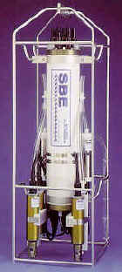
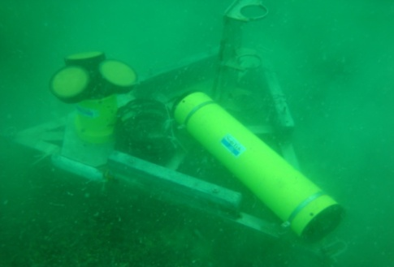
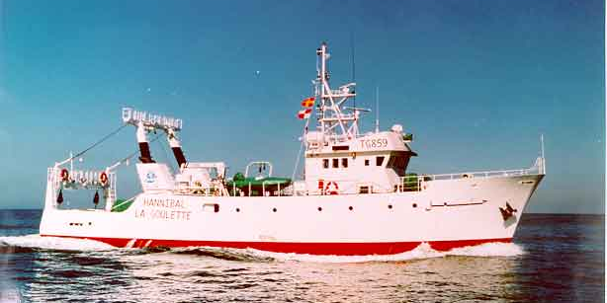
INSTM - Presentation
Ostende, 20/05/2014
INSTM is a public Research Institute with a NODC established in 1992.
The most important equipment used by Marine Environment laboratory are:
We are involved in WP :
WP2.1: participation to plenaries meetings
WP3.2, 3.3: participation to trainings
WP4.3: installation of tools for metadata
WP5.2: installation of tools for data
Seabird 9
ADCP Sontek
HANNIBAL R/V

Slide 4
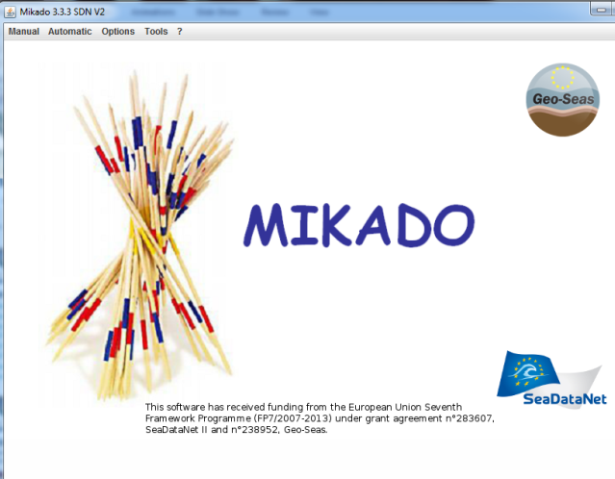
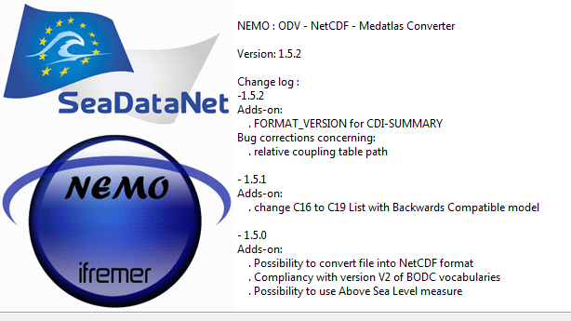
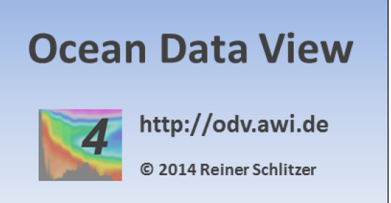

Tools used
Ostende, 20/05/2014
Hydrobase Web Application
Download Manager
Hydrobase DB
Notes:
, since e last octobre we use now the new vesrion of nemo
Our local DB called Hydrobase it is a web application connected to oraclet local data that we to exctrac

Slide 5
INSTM Contribution - Updates
Ostende, 20/05/2014
SeaDataNet Softwares:
  NEMO V1.5.2
  MIKADO V3.3.3 SDN2
  Ocean Data View V4.6.2
  Download Manager V1.4.3
Cruise Summary Report Contribution – CSR
Common Data index
Notes:
Csr its on going

Slide 6
INSTM (Tunisia) catalogues
Ostende, 20/05/2014
Catalogue | Total number
EDMED | 1
EDMERP | 33
EDMO | 1
EDIOS programmes | 0
EDIOS Series | 0
CSR | 96
CDI | 867
Notes:
EDMED: We ask the EDMED responsible center to confirm our entri¥y.
CSR are completely updated
CDI Update on progress.

Slide 7
Ostende, 20/05/2014
Notes:
Pas de difference

Slide 8
INSTM – requested data (RSM)
Ostende, 20/05/2014

Slide 9
Problems faced
Ostende, 20/05/2014
Download Manager recurrent problems:
  DM_Batch stop running
  DM_Batch component not working correctly
  DM offline
Internet and power shutdown
Notes:
Unfortunately
Although all this problems our team are working hardly to maintain dm runining gre ces probleme notre equipe assure le bon fonctionnement du DM comme le montre la carte suivante

Slide 10
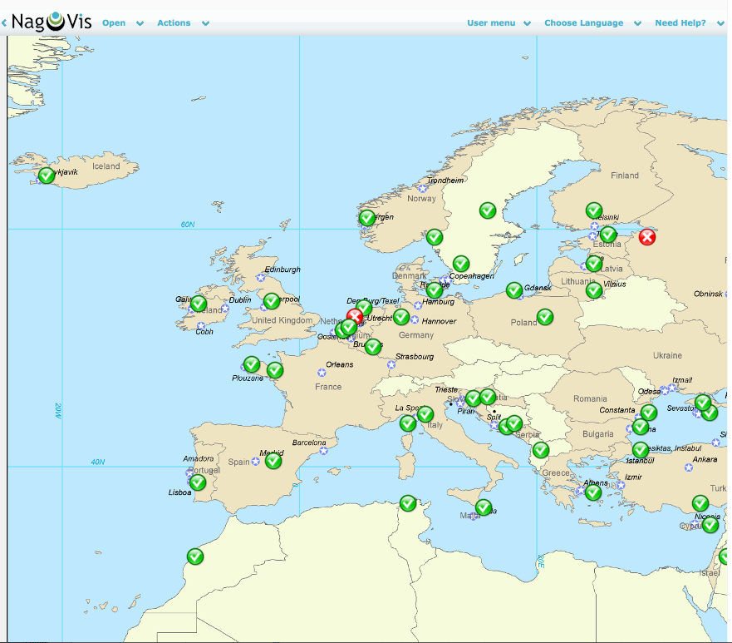
Ostende, 20/05/2014
Notes:
As can see from nagios monitoering system here this snap shot is taking yesterday and we can the dm of tunisia is working perfectly

Slide 11
Conclusion
Ostende, 20/05/2014
Strengthened our methodology in Marine data management and quality control
New publication in preparation
New CDI and CSR on going
As physical oceanographer and data provider, I am here to learn the latest versions and tools used for data management
Notes:
Seadatanet help us to improve our New publication (sana en cours dans le bulletind el’INSTM)

Slide 12
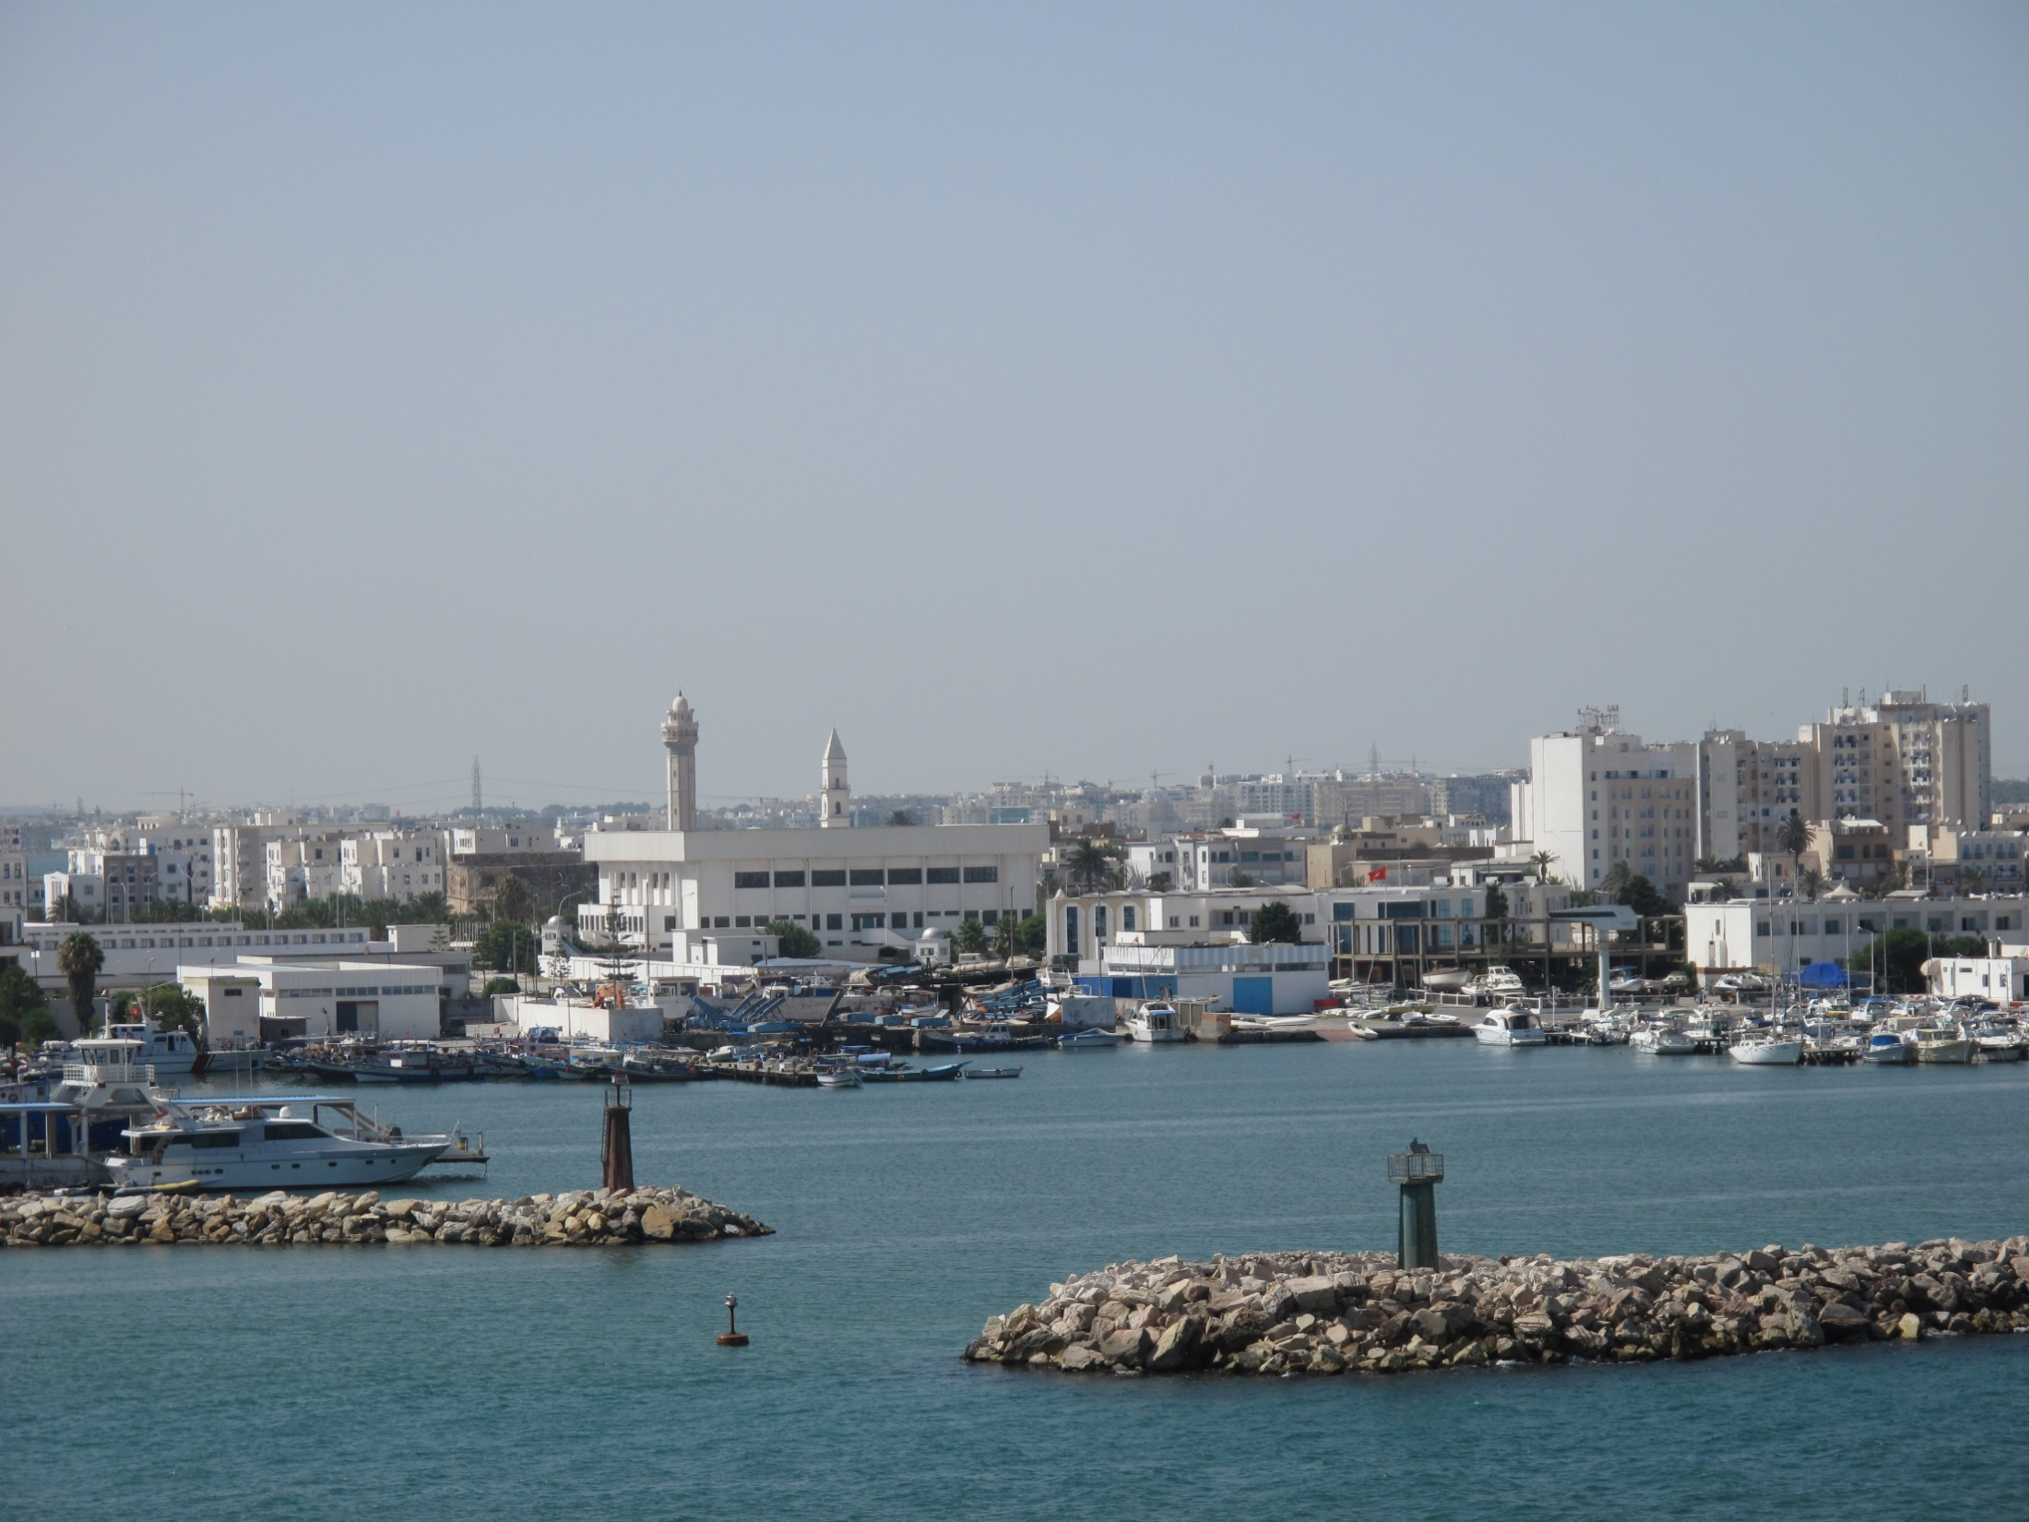
Thank you for your support
La Goulette, Août 2013

