Slide 1
Download Manager software Training Workshop Ostend, Belgium, 20th May 2014
D.M.A. Schaap - Technical Coordinator

Slide 2
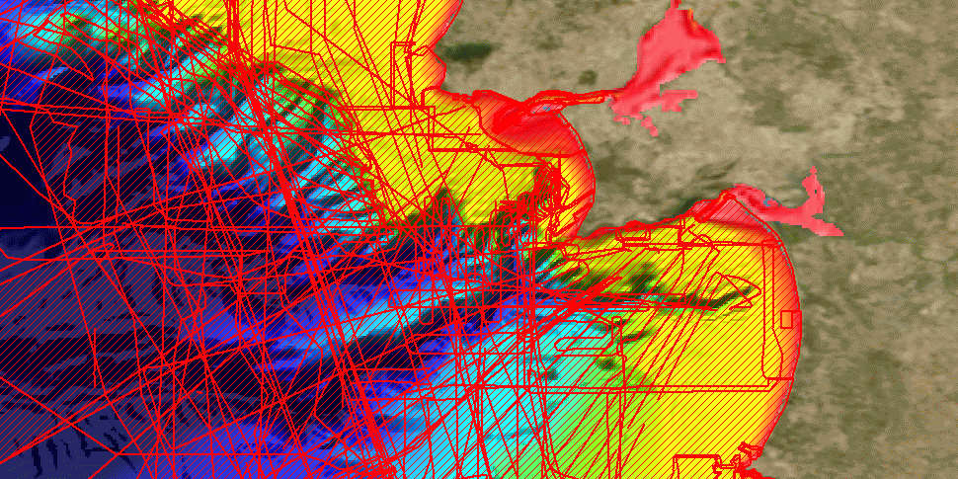
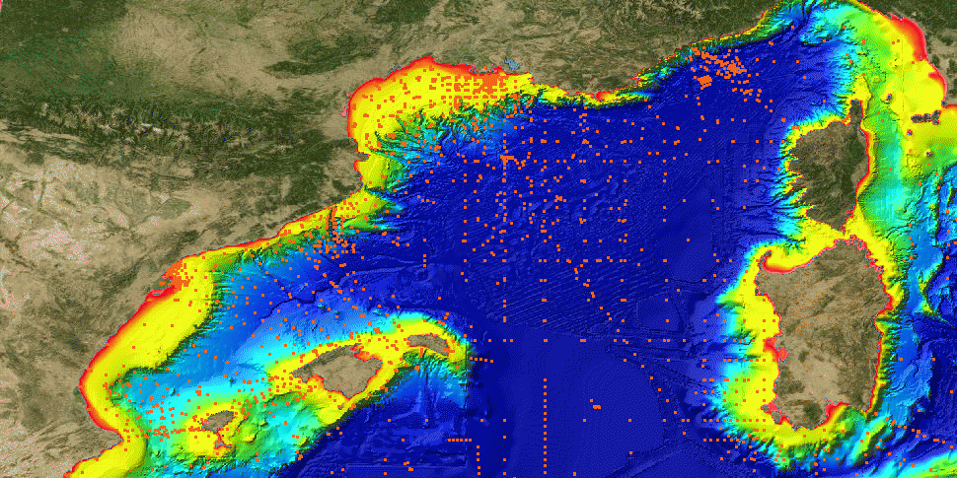
Examples of CDI search dialogue
CDI Result Maps
Bathymetric surveys near Lisbon
Portugal
Nutrients data sets
in West Med
Result maps with EMODNet Bathymetry WMS in background

Slide 3
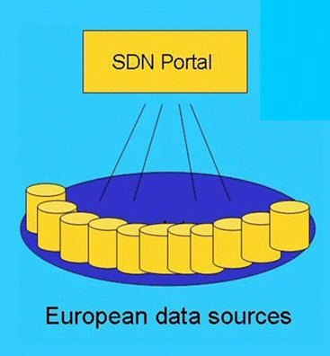
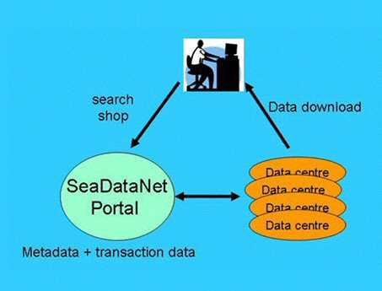
CDI service for discovery and unified access of data
Already more than 90 data centres connected and more underway

Slide 4
Components of the CDI service
User
interfaces
CDI database
Central
User
Register
Shopping basket
Request Status Manager
Download
Manager
Download
Manager
Download
Manager
data
data
data

Slide 5
Components of the CDI service
SeaDataNet CDI User Interfaces:
For users to discover relevant data sets by combinations of search criteria or by a faceted search
SeaDataNet Central User Register with User Roles db + web service :
Details of users, their organizations and addresses, Id-Passwords, Roles
SeaDataNet Shopping Basket:
Preparing a user request of multiple data sets, max 10.000 records per transaction, and routing requests to the Request Status Manager

Slide 6
Components of the CDI service
SeaDataNet Request Status Manager:
Processing and administration of all requests and data deliveries (downloads), for users in communication with data centres. For data centres to oversee all transactions.
Download Manager:
Handles communication with Request Status Manager and takes care that requested files are made ready for downloading by User (if cleared! ) in the agreed formats via a local website address.

Slide 7
RSM and Download Manager
RSM keeps IP-addresses, EDMO codes, data manager e-mail, trigger addresses etc of all connected Data Centres in config file
Download Manager is Java programme, that must be locally installed
Functions DM:
Communication with RSM Web service
Retrieving and processing order lists after being triggered
Double checking user via AAA Web service
Retrieving data files, related to requested CDI’s, via local_CDI_ID
Preparing data files in agreed and requested formats (ODV, MedATLAS, NetCDF)
Placing data files in zip format for downloading
Informing RSM Web service of order processing status and url’s
Keeping a local log
DM support for file management and database storage

Slide 8
Download Manager releases
24 January 2013 - Version 1.4.0
13 May 2013 – Version 1.4.1
23 September 2013 – Version 1.4.2
25 October 2013 – Version 1.4.3 (Current release)
26 May 2014 – Version 1.4.4 – planned release
Requirement that data centres regularly upgrade to adopt new functionalities

Slide 9
DM V1.4.3 extra features compared to V1.1f
Allows NAGIOS monitoring
PostqreSQL support added
RESTful support for coupling table modus 1
Improved DM_Checker – compares the entries in the CDI metadata catalogue with the entries in the coupling table
Improved security model
Improved client order processing – no check of client access roles
Improved splitter module
Simplified upgrade procedure

Slide 10
DM V1.4.4 extra features compared to V1.4.3
NetCDF format is supported
DM_Checker improved for checking consistency at data centre and checking coherence between local data centre and CDI central
compatible with tomcat7/java7
DM and its documentation are simpler
Maris and Ifremer can access more logs files for a better helpdesk service
bug corrections : database drivers are upgraded + a Splitter bug is corrected + a little update on servlet log display + last corrections on the bug "duplicates entry" + correction on header of ODV files + etc...

Slide 11
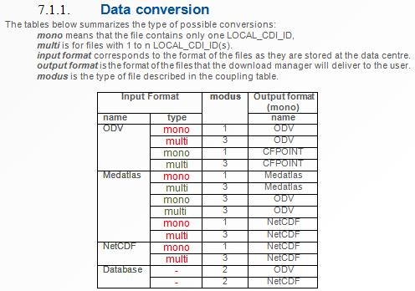
DM – Data Conversion

Slide 12
Situation with DM installations
103 Data Centres engaged with CDI infrastructure
=> 8 getting connected / in test mode
=> 6 in interim mode (without DM) and operational
=> 89 DMs installed and operational
55 Data Centres up-to-date with DM Version 1.4.3
30 Data Centres still at DM Version 1.2.0
4 Data Centres even at older version of DM!
Data centres should upgrade to adopt new functionalities and to make the SeaDataNet CDI service more robust and homogeneous

Slide 13
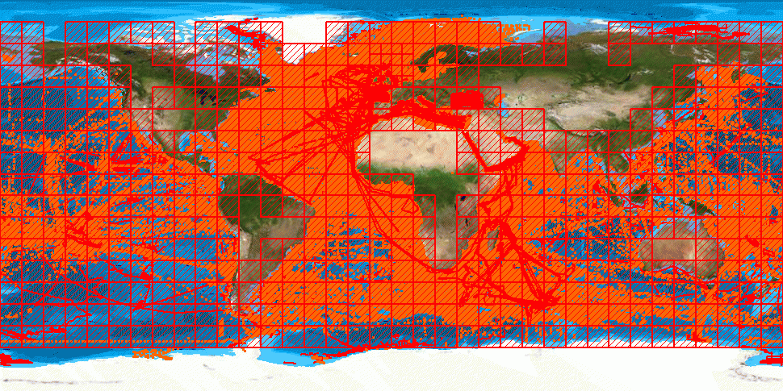
> 1,55 million CDI entries from 34 countries and 95 data centres and 487 originators for physics, chemistry, geology, geophysics, bathymetry and biology; years 1800 – 2014;
85% unrestricted or under SeaDataNet licence

Slide 14
DM installation / upgrading in test mode
Preparing test CDI XML records using latest MIKADO software
Inclusion in CDI test service by MARIS
Installing and configuring the Download Manager software in test mode in dialogue with MARIS
Choosing between pre-processed data files OR conversion via the Download Manager
Completing the coupling table between the LOCAL_CDI_ID (in the CDI XML records) and the local data sets / database queries
Testing the well functioning of the shopping process together with MARIS
If ok, migration to production mode

Slide 15
Nagios monitoring
Monitoring of the infrastructure by NAGIOS software for core services centrally based (website, catalogues querying) and for local services (downloading)

Slide 16
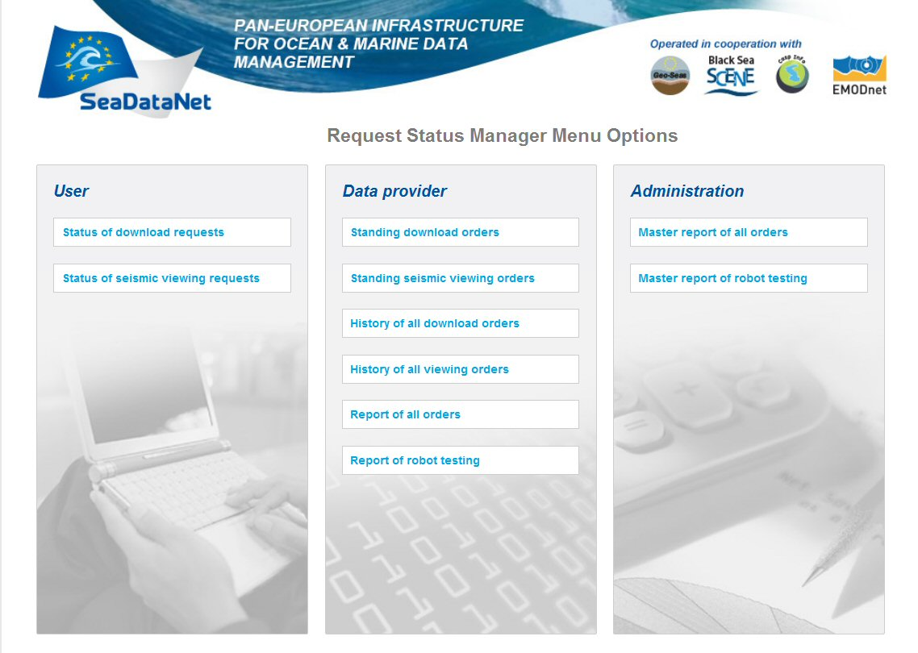
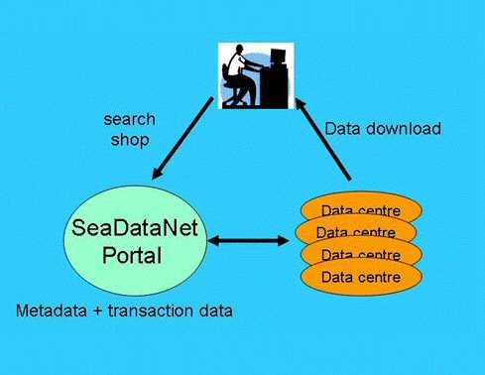
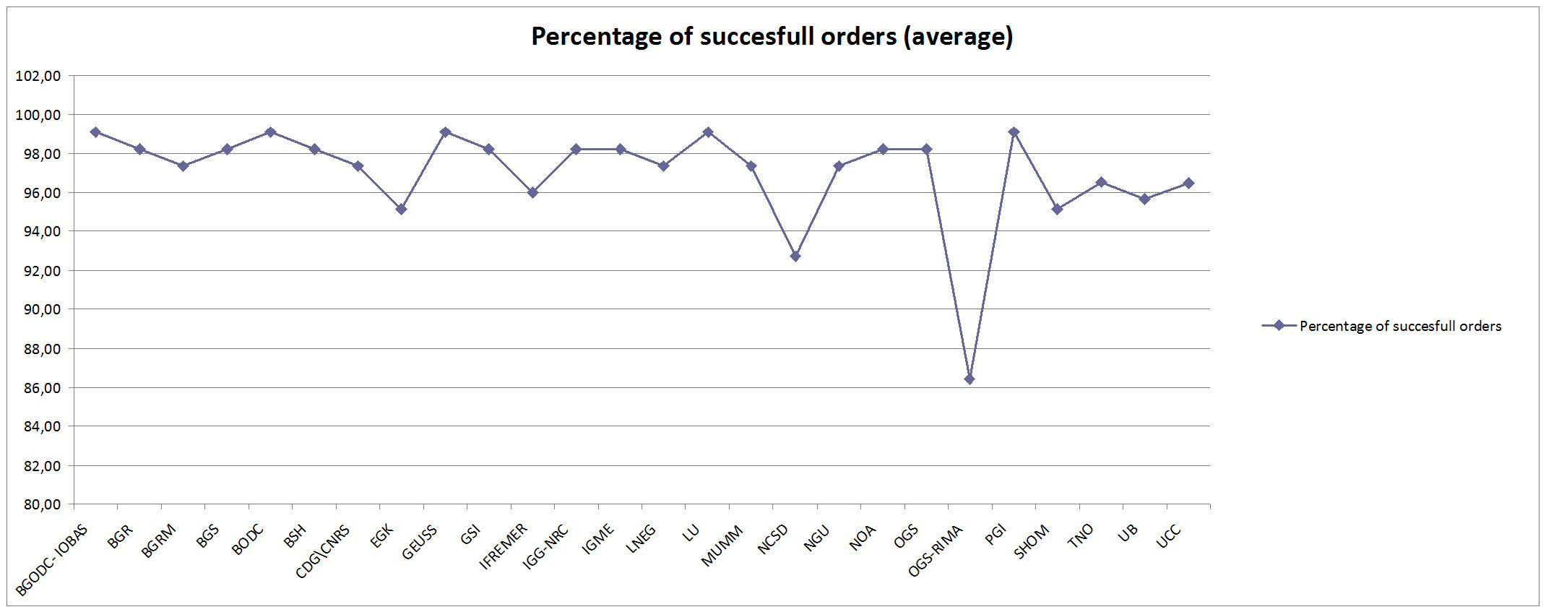
Monitoring of shopping process
Monitoring of the well functioning of the CDI data requesting and downloading process between central portal and connected data centres by ROBOT user, alert mailings and RSM logging of all steps

Slide 17
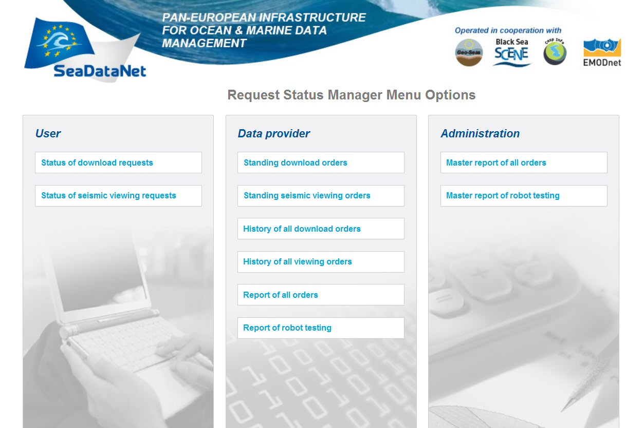
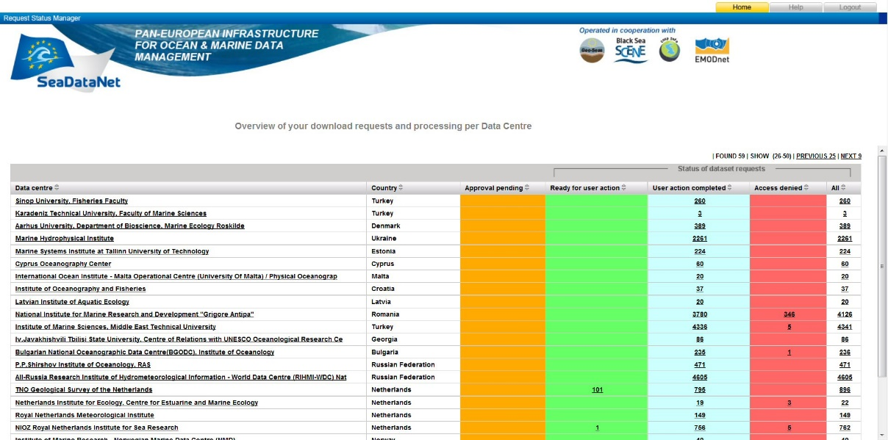
Request Status Manager
Tracking and tracing of all shopping requests
By users
By data providers
Analysis of transactions
Checking status of orders and downloading from data providers

Slide 18
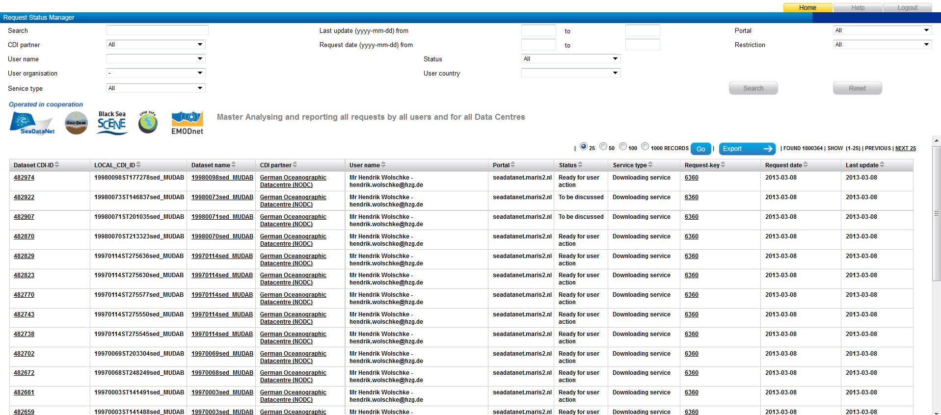
Request Status Manager - reporting
Overseeing all transactions and preparing reports

Slide 19
Upgrading DM
Latest version of DM including documentation is always available in the SeaDataNet extranet
Installation & configuration in communication with MARIS
Read carefully the documentation with configuration instructions
In case of issues, both MARIS and IFREMER provide support
Need for local IT expert with good understanding of local computer & network configurations and security arrangements

