Slide 1
IFREMER work-flow for production of CDIs data
M. Fichaut, IFREMER
Michèle Fichaut, IFREMER, SISMER

Slide 2
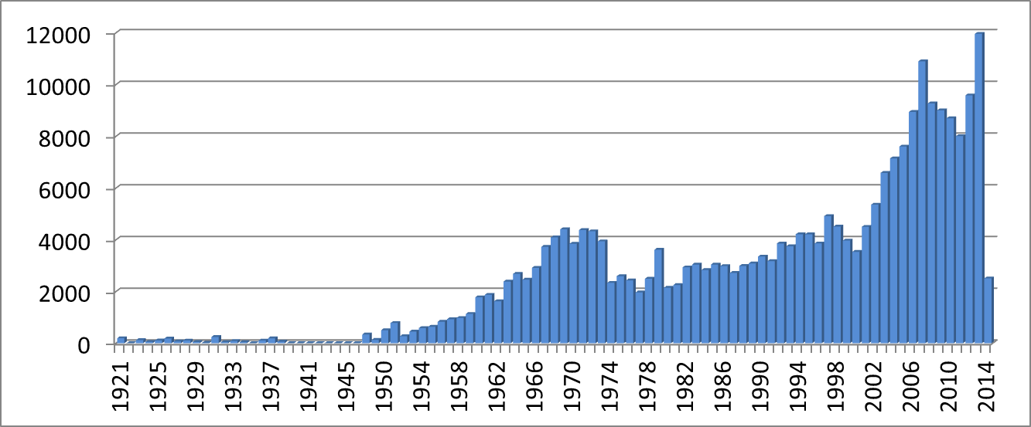
Data inventory : 234 606 CDIs from 137 labs
Per Instrument | Datasets
Argo floats | 81 984
bathythermographs | 60 128
discrete water samplers | 43 841
CTD | 40 093
current meters | 2 116
Total | 228162
Access | %
SDN licence | 62.4
Unrestricted | 35.0
By negociation | 2.6

Slide 3
Two work flow descriptions
Delayed mode data
Physical and chemical data collected during French cruises : CTDs, Discrete water samples, Current meters,…
Near real time data
French Argo floats data

Slide 4
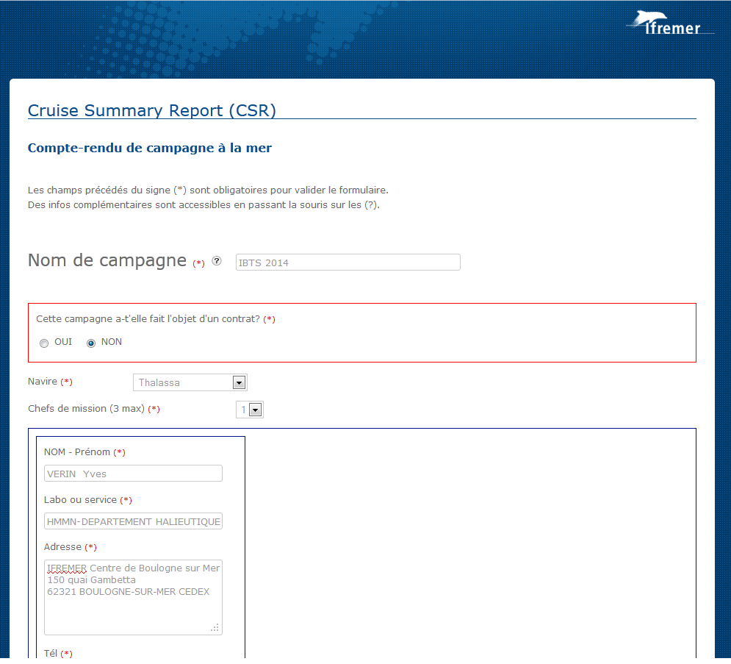
Work-flow – Phys/Chem data from French cruises
1. Input of CSR in IFREMER database
SISMER DB
Once a year
SISMER DB ➔ ➔SDN CSR catalogue

Slide 5
Work-flow – Phys/Chem data from French cruises
2. Input of metadata linked to CSR’s (in // to step 1)
SISMER DB
if
New project (EDMERP)
New Organisation (EDMO)
New dataset (EDMED)
New chief scientist
SISMER DB ➔ ➔SDN EDMO, EDMED and EDMERP catalogues

Slide 6
Work-flow – Phys/Chem data from French cruises
3. Data recovery from French laboratories
From French CSRs Chief scientists
Once a year
SISMER DB

Slide 7
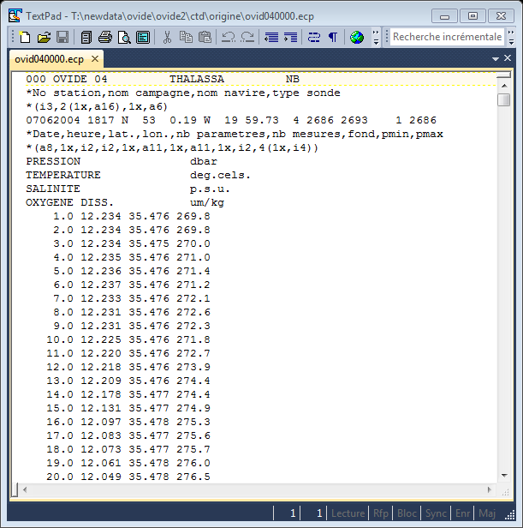
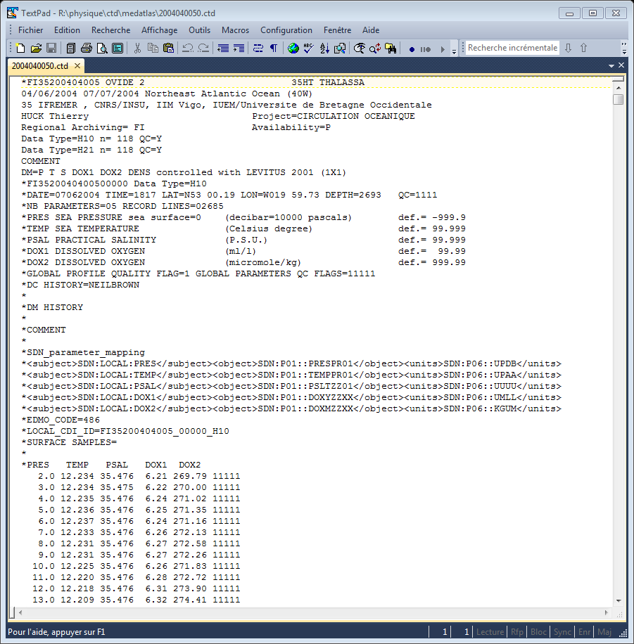
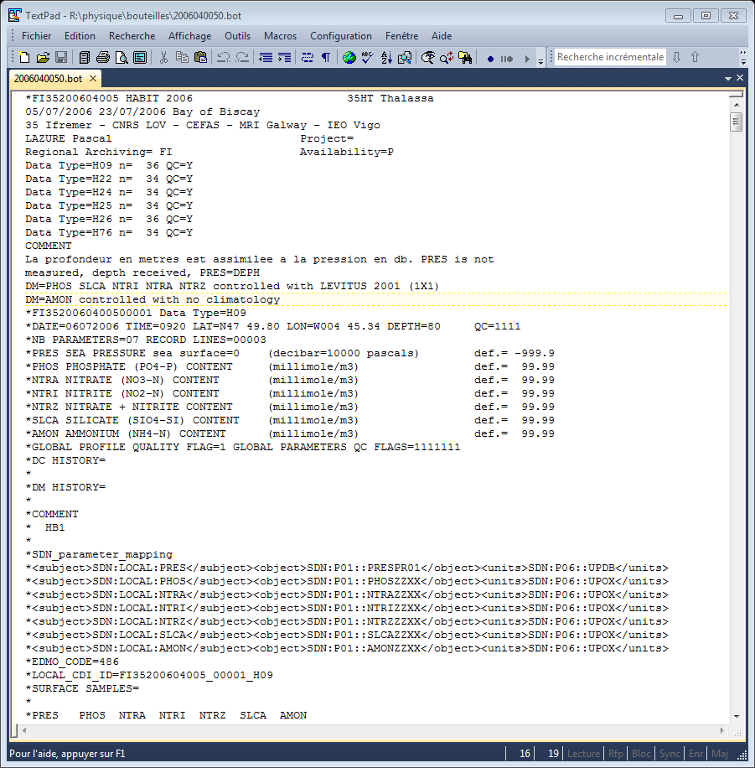
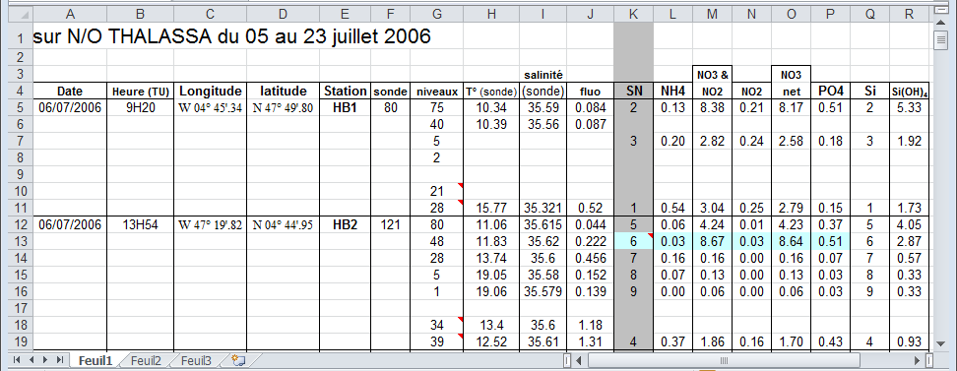
Work-flow – Phys/Chem data from French cruises
4. Reformating data files, per cruise and per data type
Files at format X Files at SDN format (MEDATLAS)
No standard vocabulary Standard SDN vocabulary

Slide 8
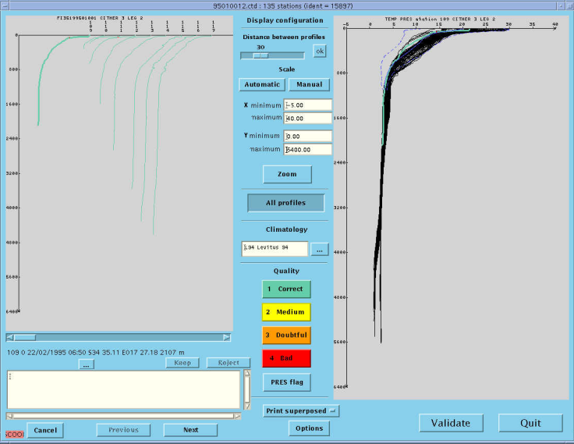
Work-flow – Phys/Chem data from French cruises
5. Quality checks (same flag scale than SDN), par data type (CTDs, Bottle…), cruise per cruise
IFREMER SCOOP Software
File format SDN
MEDATLAS
No QC
File format SDN
MEDATLAS
QC

Slide 9
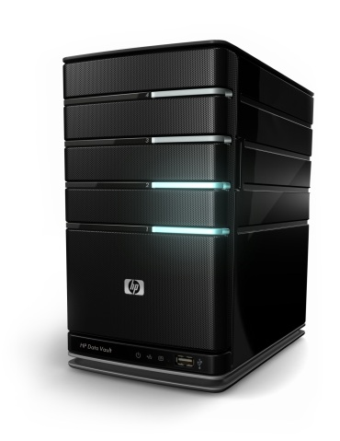
Work-flow – Phys/Chem data from French cruises
6. Archiving
DB SISMER
Metadata loading
in-house software
File format SDN
MEDATLAS
QC
IFREMER server
File archiving
MEDATLAS files

Slide 10
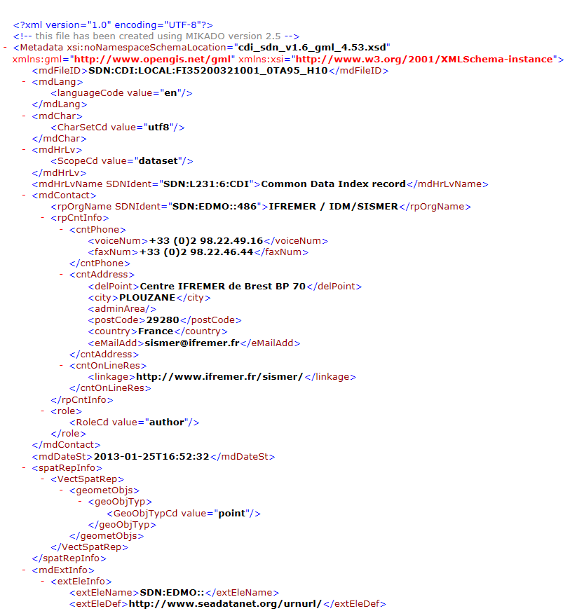
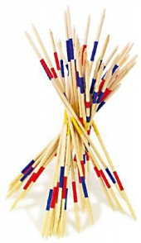
Work-flow – Phys/Chem data from French cruises
7. CDIs XML generation, new data and updated data (timestamp in the DB)
MIKADO
XML for CDIs
SISMER DB
Twice a year

Slide 11
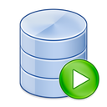
Work-flow – Phys/Chem data from French cruises
8. Update of the coupling table
COUPLING table
ID | Number (38,0)
LOCAL_CDI_ID | Varchar2 (64)
MODUS | Number (1,0)
FORMAT | Varchar2 (8)
FILENAME | Varchar2 (521)
SQL_QUERY | Varchar2 (4000)
CONNECTION_STRING | Varchar2 (128)
LOGIN | Varchar2 (20)
PASSWORD | Varchar2 (20)
MAPPING_FILE | Varchar2 (128)
XMLEXPORT_DATE | Date
COUPLING table
ID | 12345
LOCAL_CDI_ID | Local_unique_id
MODUS | 3
FORMAT | MEDATLAS
FILENAME | filename
SQL_QUERY
CONNECTION_STRING
LOGIN
PASSWORD
MAPPING_FILE
XMLEXPORT_DATE | 24/06/2009
Update
Coupling table
SQL query with
SQL developper
SISMER DB
Twice a year

Slide 12
Work-flow – Phys/Chem data from French cruises
9. CDIs XML sent to MARIS
Twice a year
Manual
CatalogueService
Web
XML for CDIs
Automatic
MARIS central catalogue

Slide 13
Work-flow – French Argo float
1. Data and metadata loaded in IFREMER database
Argos
Irridium
Coriolis DB
CLS
Automatic QC
Every day

Slide 14
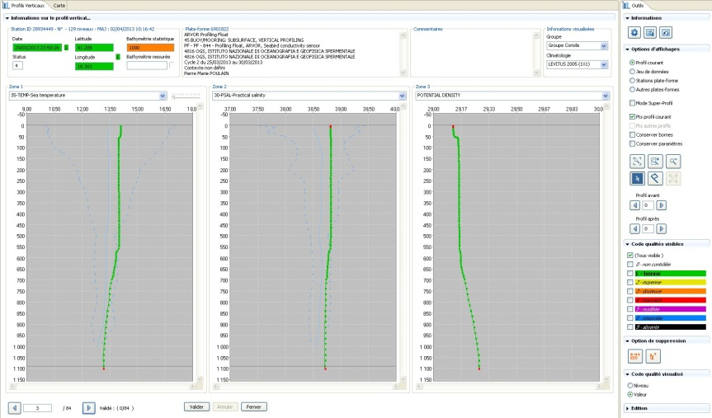
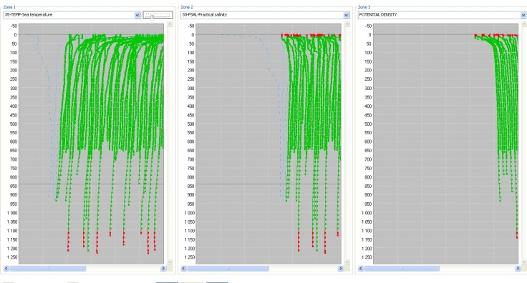
Work-flow – French Argo float
2. Manual QC of the data, by set of data not yet manually QCed
Coriolis DB
IFREMER SCOOP2 software
Every working day

Slide 15
Work-flow – French Argo floats
3. CDIs XML generation, new data and updated data (timestamp in the DB)
MIKADO
XML for CDIs
CORIOLIS DB
Every month

Slide 16
Work-flow – French Argo floats
4. Update of the coupling table
COUPLING table
ID | 12345
LOCAL_CDI_ID | Local_unique_id
MODUS | 2
FORMAT | ODV
FILENAME | filename
SQL_QUERY | Sql_query
CONNECTION_STRING | jdbc:oracle…
LOGIN | login
PASSWORD | password
MAPPING_FILE | Map_Argo
XMLEXPORT_DATE | 24/06/2009
Update
Coupling table
SQL query with
SQL developper
SISMER DB
Every month

Slide 17
Work-flow – French Argo floats
5. CDIs XML sent to MARIS
Every month
Manual
CatalogueService
Web
XML for CDIs
Automatic
MARIS central catalogue

