Slide 1
Tools for generation of SDN NetCDF (CFPOINT) files
M. Fichaut, IFREMER
Michèle Fichaut, IFREMER, SISMER

Slide 2
New format definition implies
Upgrading of the existing tools
NEMO
Download manager
Development of new tools
Format converters
OdvSDN2CFPOINT
MedSDN2CFPOINT

Slide 3
Upgrading of NEMO software
NEW
SeaDataNet Vocabulary
NVS 2.0
Collection
of
ASCII files
SeaDataNet
files
IMPROVED
Above sea level data
ODV
MEDATLAS
NETCDF
NEW
Coupling table
CDI summary
CSV file
IMPROVED
Format version
Export
Coupling table

Slide 4
Upgrading of NEMO software
NEW
since v1.5.0 released in July 2013
Current version: v1.5.3

Slide 5
NEMO for NetCDF
Same principles than for ODV and MEDATLAS
input ASCII file(s)
Description in NEMO
Output as NetCDF file mono-station or multi-stations

Slide 6
NetCDF format mono or multi-station
NEW
for vertical profiles, time- series and trajectories
Notes:
Nouveau Radio bouton pour NetCDF mono ou multistations

Slide 7
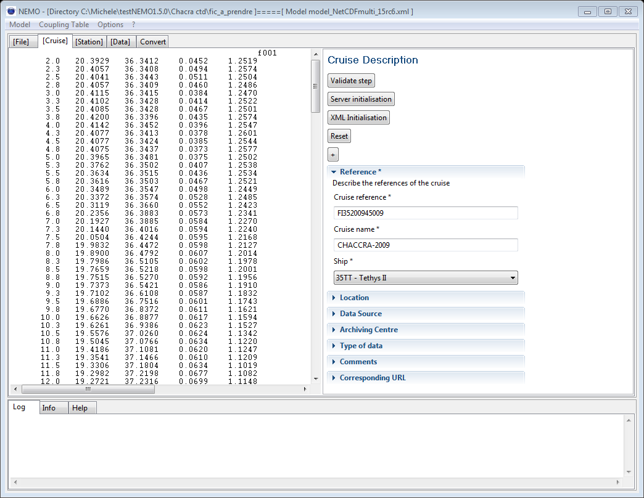
NetCDF cruise metadata
NEW
Notes:
Nouvelle cruise description pour NetCDF, moins de metadonnées que pour MEDATLAS, pour ODV écran inexsistant

Slide 8
SDN NetCDF format
NEW
CSR ISO-19139 available
Cruise information
Reference
Name
Ship
Mandatory

Slide 9
SDN NetCDF format
NEW
Cruise information
Location is a C19 vocabulary

Slide 10
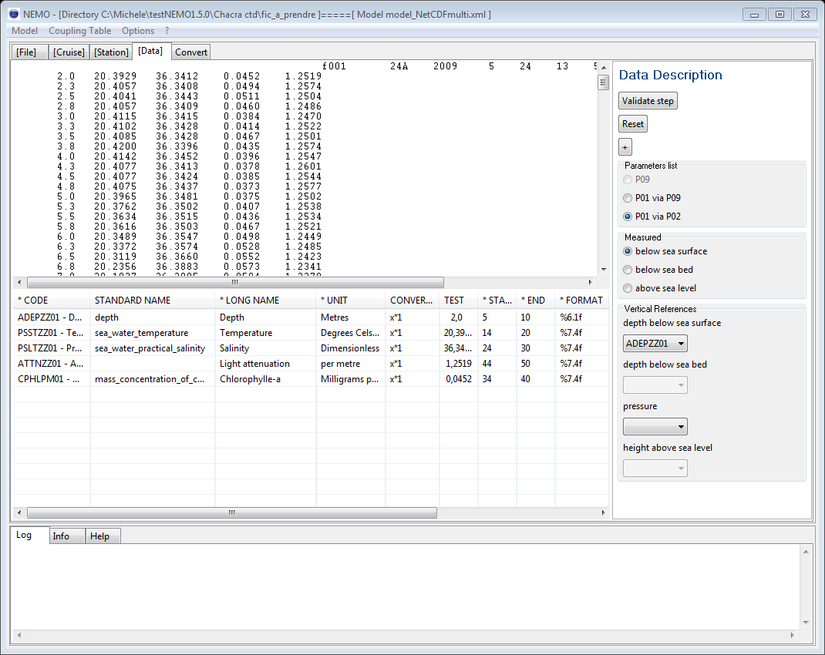
NetCDF special features for data description
Not Mandatory but recommended
P07 vocab
Mandatory
Free text
NEW

Slide 11
Upgrading of DM software
Download manager v1.4.4
Still under test
Next release planned on 26 May 2014
Able to
Generate NetCDF on the fly from data in database
Reformat SDN ODV or SDN MEDATLAS files to SDN NetCDF files on the fly
Split multi-station SDN NetCDF files into mono-station SDN NetCDF file

Slide 12
Possible conversions with DM 1.4.4
Input format:
Format at which files are stored in the data centre
Output format:
Format at which the DM delivers the data
mono: 1 LOCAL_CDI_ID
multi: n LOCAL_CDI_IDs
Input format |  | Modus | Output format (always mono)
Name | Type
CFPOINT | mono | 1 | CFPOINT
 | multi | 3 | CFPOINT
MEDATLAS | mono | 1 | CFPOINT
 |  |  | MEDATLAS
 |  | 3 | ODV
 | multi | 3 | CFPOINT
 |  |  | MEDATLAS
 |  |  | ODV
ODV | mono | 1 | CFPOINT
 |  |  | ODV
 | multi | 3 | CFPOINT
 |  |  | ODV
Database | -- | 2 | ODV
 | -- | 2 | CFPOINT
Input format |  | Modus | Output format (always mono)
Name | Type
CFPOINT | mono | 1 | CFPOINT
 | multi | 3 | CFPOINT
MEDATLAS | mono | 1 | CFPOINT
 |  |  | MEDATLAS
 |  | 3 | ODV
 | multi | 3 | CFPOINT
 |  |  | MEDATLAS
 |  |  | ODV
ODV | mono | 1 | CFPOINT
 |  |  | ODV
 | multi | 3 | CFPOINT
 |  |  | ODV
Database | -- | 2 | ODV
 | -- | 2 | CFPOINT

Slide 13
To deliver your files under several formats
It is mandatory to have all possible formats in the CDI metadata:
var37 and var38 of MIKADO possible values:
Var 37 : Format name | Var 38: Format version
CFPOINT | 1.0
MEDATLAS | 2.0
ODV | 0.4

Slide 14
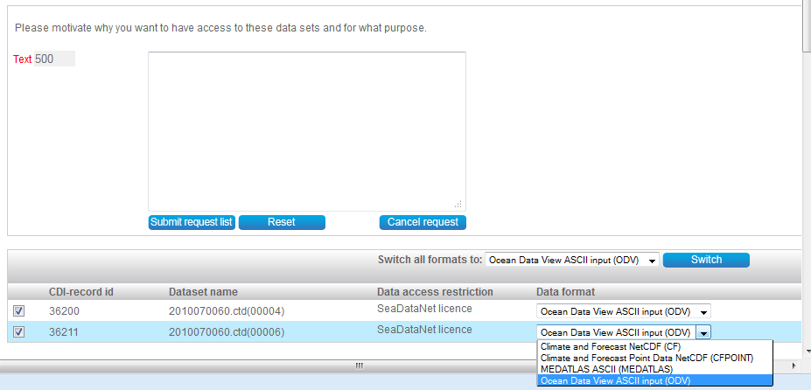
Then formats are available for downloading

Slide 15
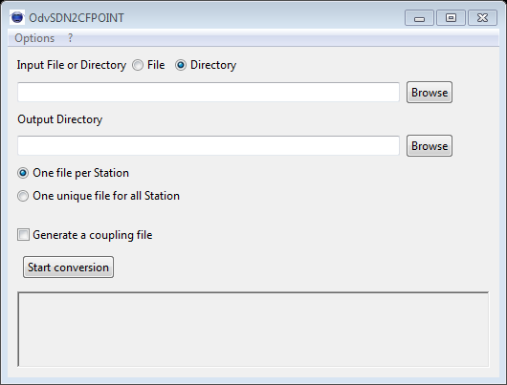
New tools for format conversion (1)
OdvSDN2CFPOINT v1.0.3
Converts files at SDN ODV format ➔ to files at SDN NetCDF format
1, n ODV mono-station ➔ 1,n NetCDF mono-station
1 to n ODV multi-station ➔ 1,n NetCDF mono-station
1 to n ODV multi-station ➔ 1,n NetCDF multi-station
Java tool, needs Java > 1.6

Slide 16
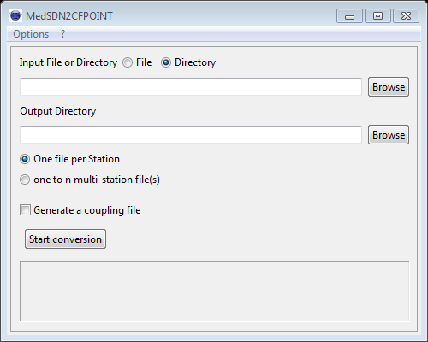
New tools for format conversion (2)
MedSDN2CFPOINT v1.0.4
Converts files at SDN MEDATLAS format ➔ to files at SDN NetCDF format
1, n MEDATLAS mono-station ➔ 1,n NetCDF mono-station
1 to n MEDATLAS multi-station ➔ 1,n NetCDF mono-station
1 to n MEDATLAS multi-station ➔ 1,n NetCDF multi-station
Java tool, needs Java > 1.6

Slide 17
Same user interface for the 2 tools

Slide 18
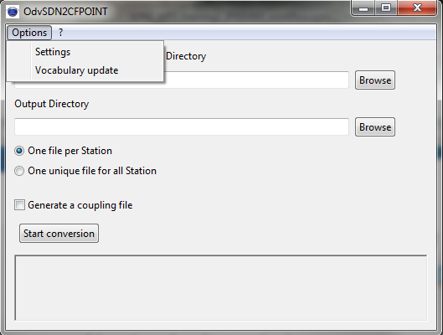
Option menu

Slide 19
Option - Settings

Slide 20
Option – Vocabulary update

Slide 21
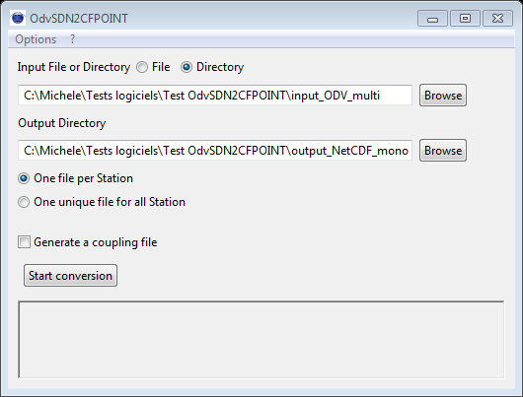
Main screen : input and output directories
Input : ODV
Output: NetCDF
Choose output mono or multi station files
While converting, generation of a coupling file is possible

Slide 22
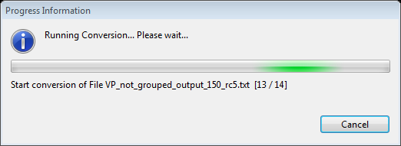
Running the conversion
Input files counter

Slide 23
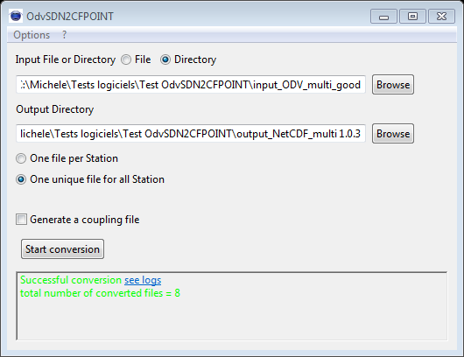
Running the conversion
Conversion ends with success

Slide 24
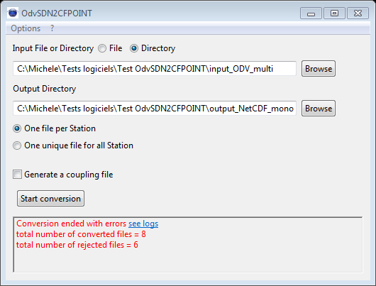
Running the conversion
Conversion ends with errors

Slide 25
See the log file : look up for ERROR
ERROR 30: SDN parameter object PSSTZZ01 not found in BODC list

Slide 26
PSSTZZ01 has been deprecated
It is recommended to use TEMPPR01 in stead of PSSTZZ01

