Slide 1
Monitoring Services
Stavroula Balopoulou , Angelo Lykiardopoulos, Sissy Iona
HCMR-HNODC
2nd SeaDataNet Training Session,
20-22 May 2014 – UNESCO/IOC Project office for IODE, Ostend, Belgium

Slide 2
Outline
Introduction to Network Monitoring
Monitored Services
Monitoring Portal
Access Portal Web application
Login as “SeaDataNet user”
Portal’s Main menu
Monitoring Network
Current State -> Services
Current State -> Service Groups
State Reports -> Service(s) Availability Index
State Reports -> State Breakdowns (Availability)
State Reports -> State History (Trends)
Alerts Reports -> Latest Critical Events
Alerts Reports -> Alerts Summary
Alerts Reports -> Alerts Histogram
Add other service(s)-> Add your service
Account
Contact -> Send your request/comments
Planned portal changes

Slide 3
Introduction to Network Monitoring
The term network monitoring describes the use of a system that constantly monitors a computer network for slow or failing components and notifies (via email, SMS, e.t.c.) the network and local administrators in case of outages.
In the framework of SeaDataNetII project a network monitoring system was developed in order to monitor the SeaDataNet components (Download Managers, Central Catalogues, Common Vocabularies, Central Authentication Service) that is based on Nagios software.
To correct the SDN modules’ malfunctions local administrators need more than a notification email, they need to have access to Nagios log files to get more detailed information about the source of the problem.
A user friendly Monitoring Portal is designed and developed for local administrators who are responsible to maintain their services up and running.

Slide 4
Monitored Services
The SeaDataNet components that are monitored are divided into two groups of services:
The Core services, which are centrally-based provided services:
Common Data Index (CDI) portal
European Directory of Marine Organisations (EDMO) portal
European Directory of the initial Ocean-observing Systems (EDIOS) portal
European Directory of Marine Environmental Research Projects (EDMERP) portal
European Directory of Marine Environmental Research Projects (EDMED) portal
Cruise Summary Reports (CSR) portal
SeaDataNet homepage
SDN Central Authentication Service
Common Vocabularies Web Services
The Local services, which are services that are provided by the partners' infrastructures.
85 Download Managers supporting SeaDataNet, GeoSeas, UBSS and EMODNet-Chemistry projects

Slide 5
Monitoring Portal
The Monitoring Portal is an online web interface that is addressed to local administrators who are responsible to maintain their services up and running smoothly. The portal provides to users the capability:
to search and access a variety of detailed information about their own servers and services status and logs
to view all SeaDataNet's services status of operation (availability)
to record and show the history of their servers/services operation status
to calculate a percentage of their services uptime (availability indicator)
In order to access the portal it is required to:
Be the responsible person for the maintenance of a local or core SDN service ( e.g. SDN Download Manager)
Register as SeaDataNet user and obtain a SeaDataNet user ID (if not registered)
Send an email to cdi-support@maris.nl to add your download service at the monitoring system by providing the necessary information: name, edmo code and country of your organisation, person(s) notified by the system contact info (full name and email) and SeaDataNet user ID(s), if you have installed DM or other download service, URL of your download service, project(s) you are involved (SeaDataNet, GeoSeas, UBSS, EMODnet Chemistry)

Slide 6
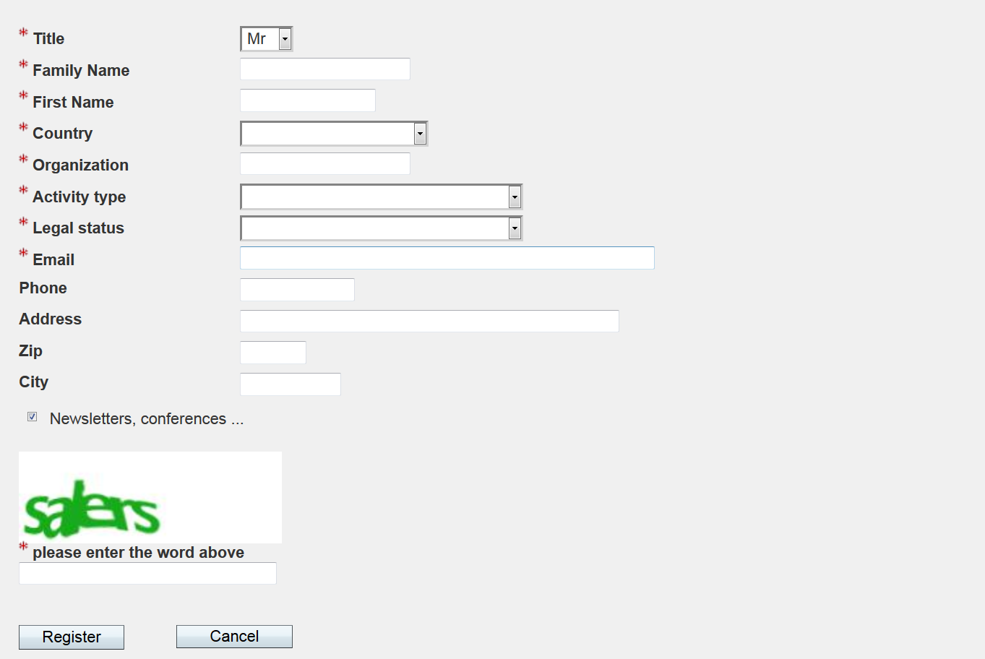
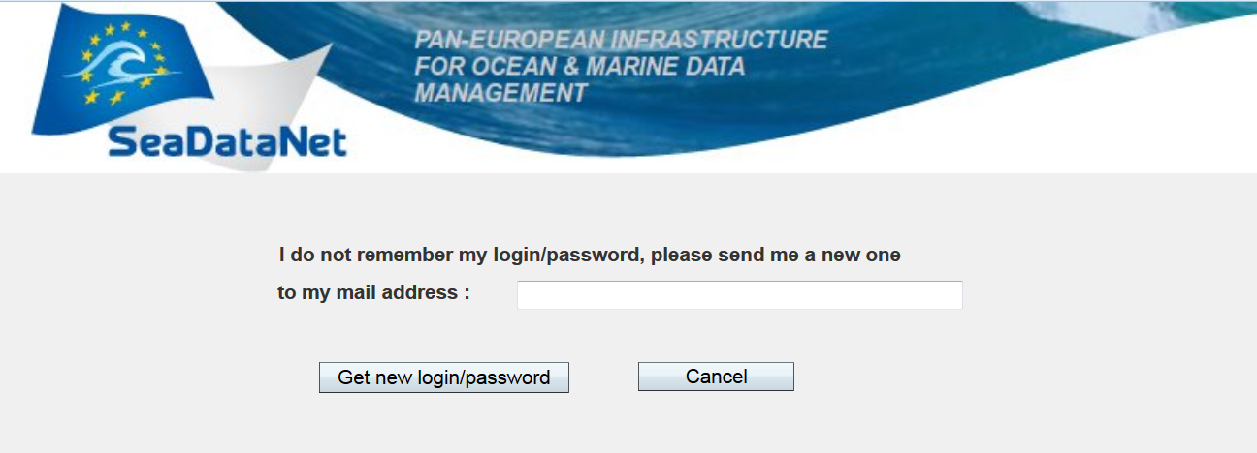
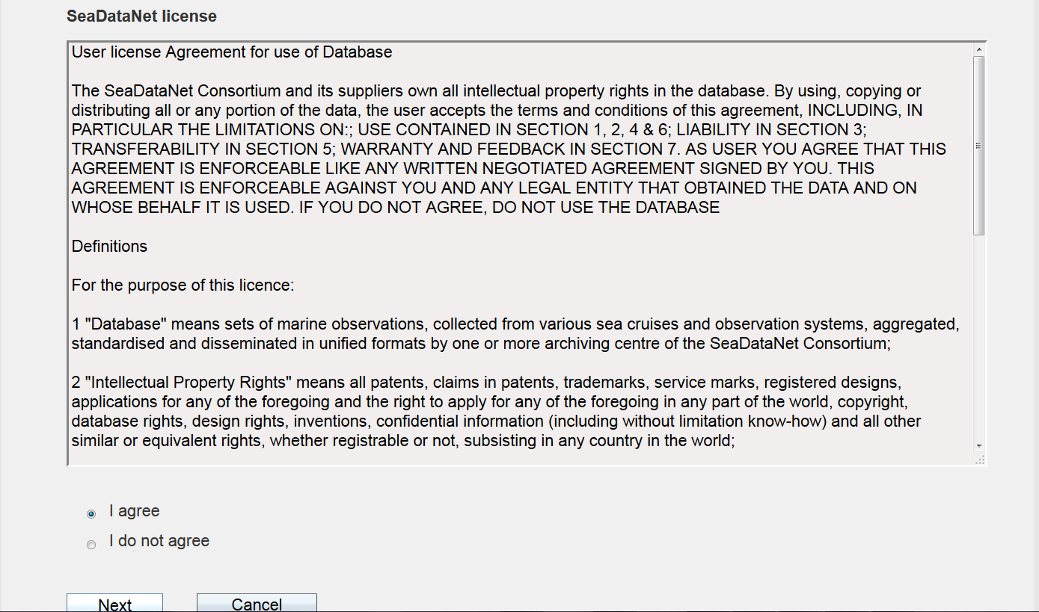
Access Portal Web application
To access the portal open your web browser and type the following URL: http://seadatanetnm.hcmr.gr/portal.

Slide 7
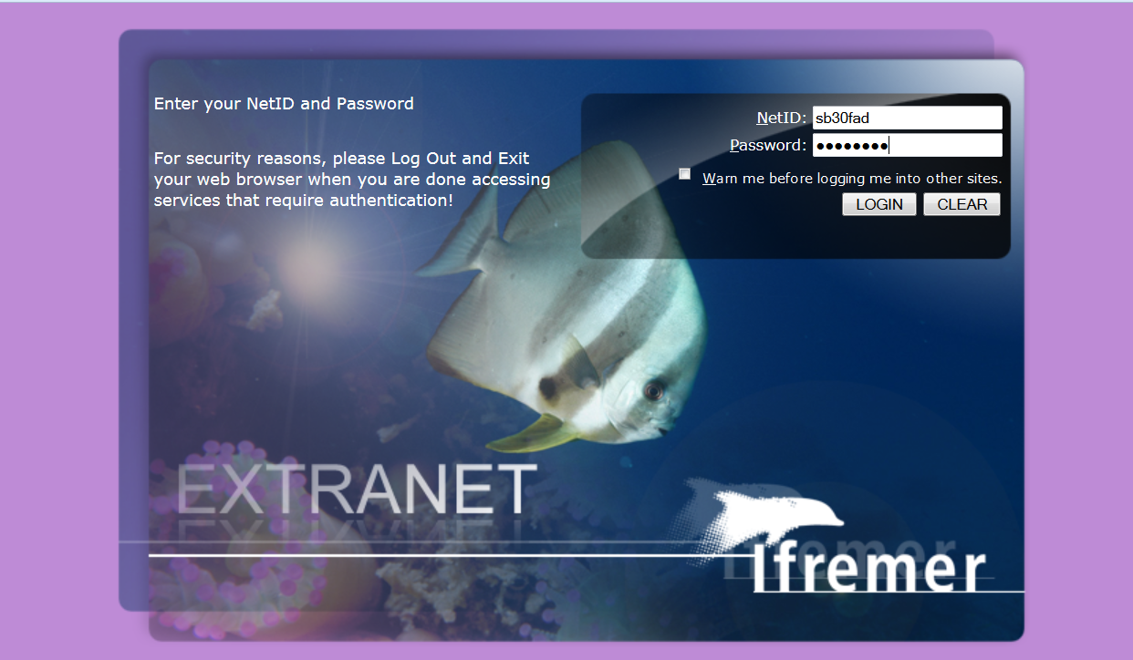
Login as “SeaDataNet user”

Slide 8
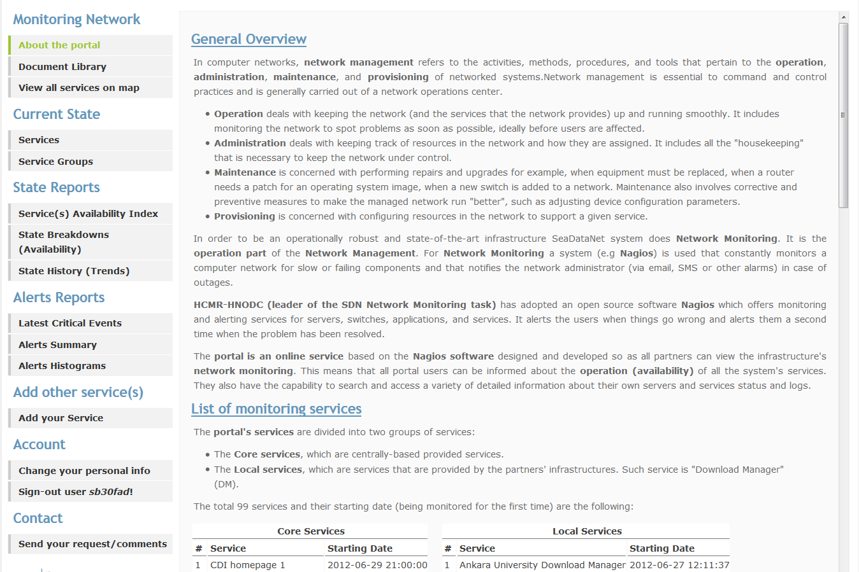
Portal’s Main Menu

Slide 9
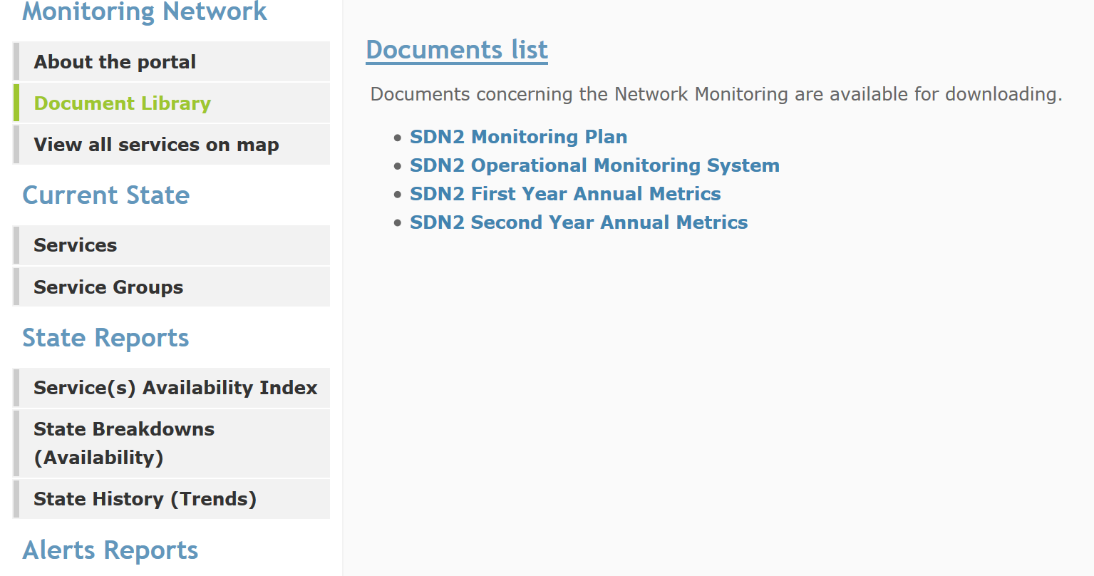
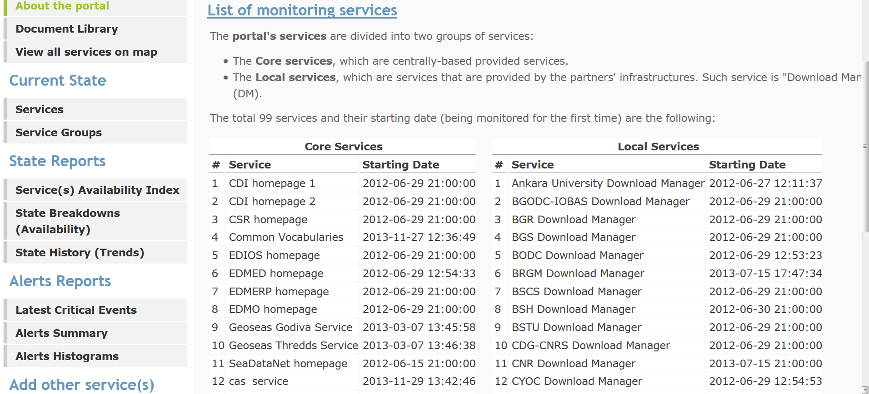
“Monitoring Network”

Slide 10
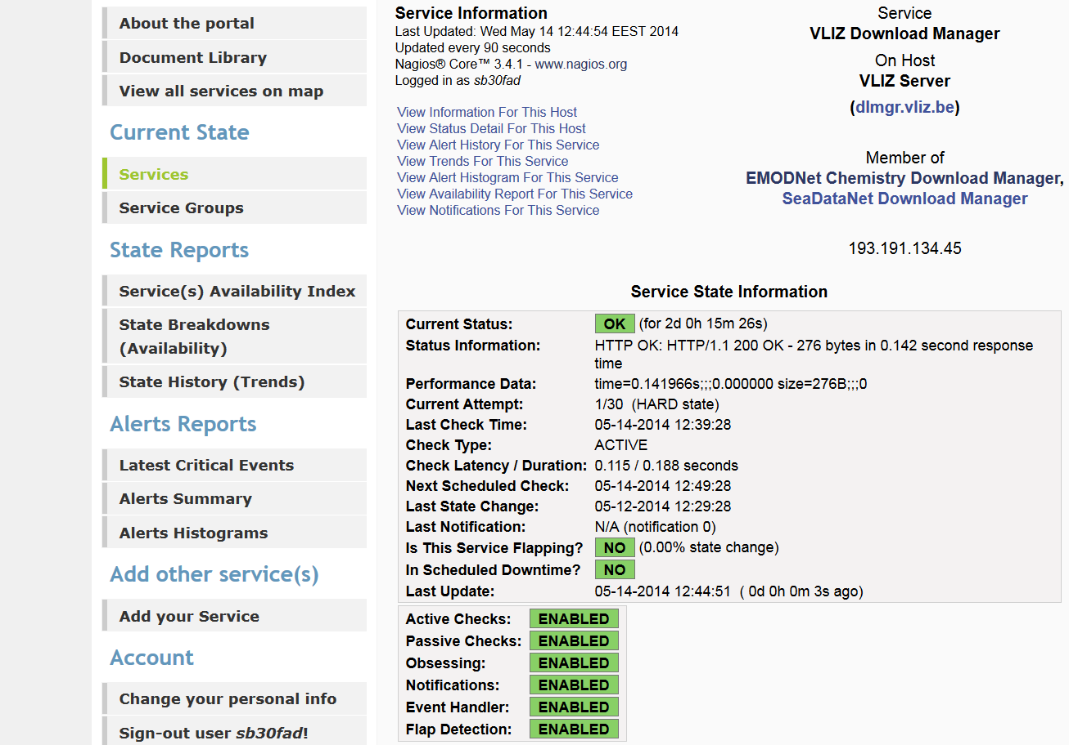
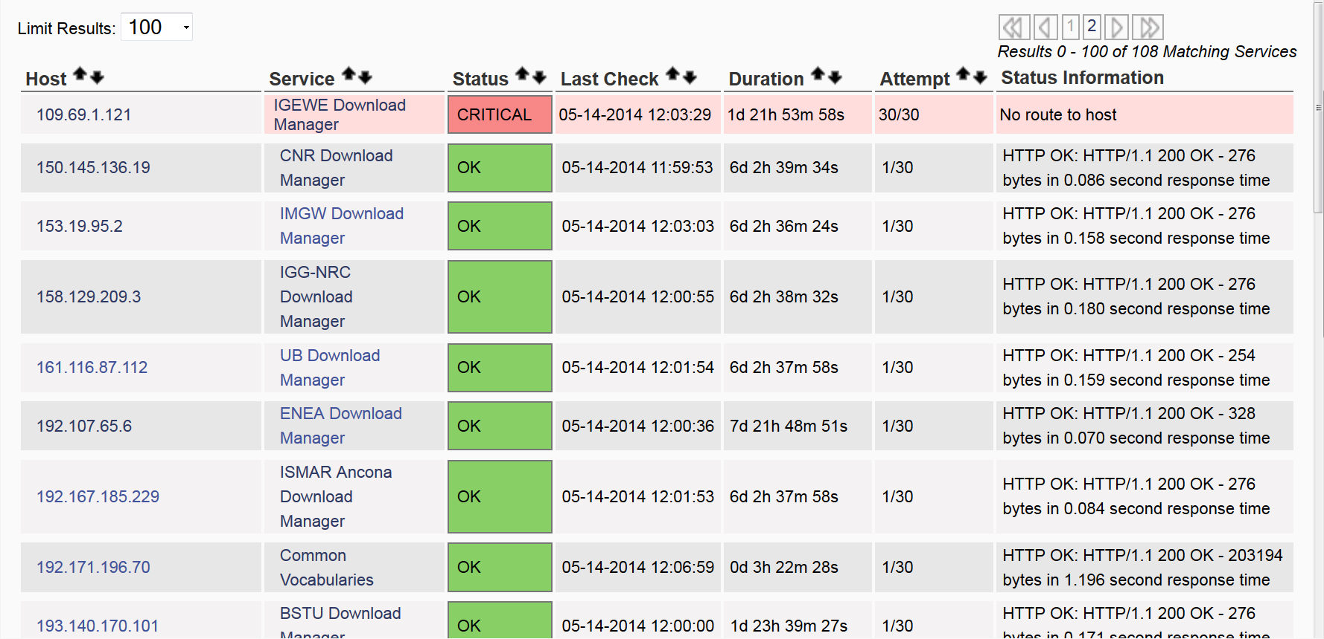
Current State -> Services
Clicking on a service additional information about its state is displayed
Detailed view of the current state of all services that are associated with a particular user (the logged in user)

Slide 11
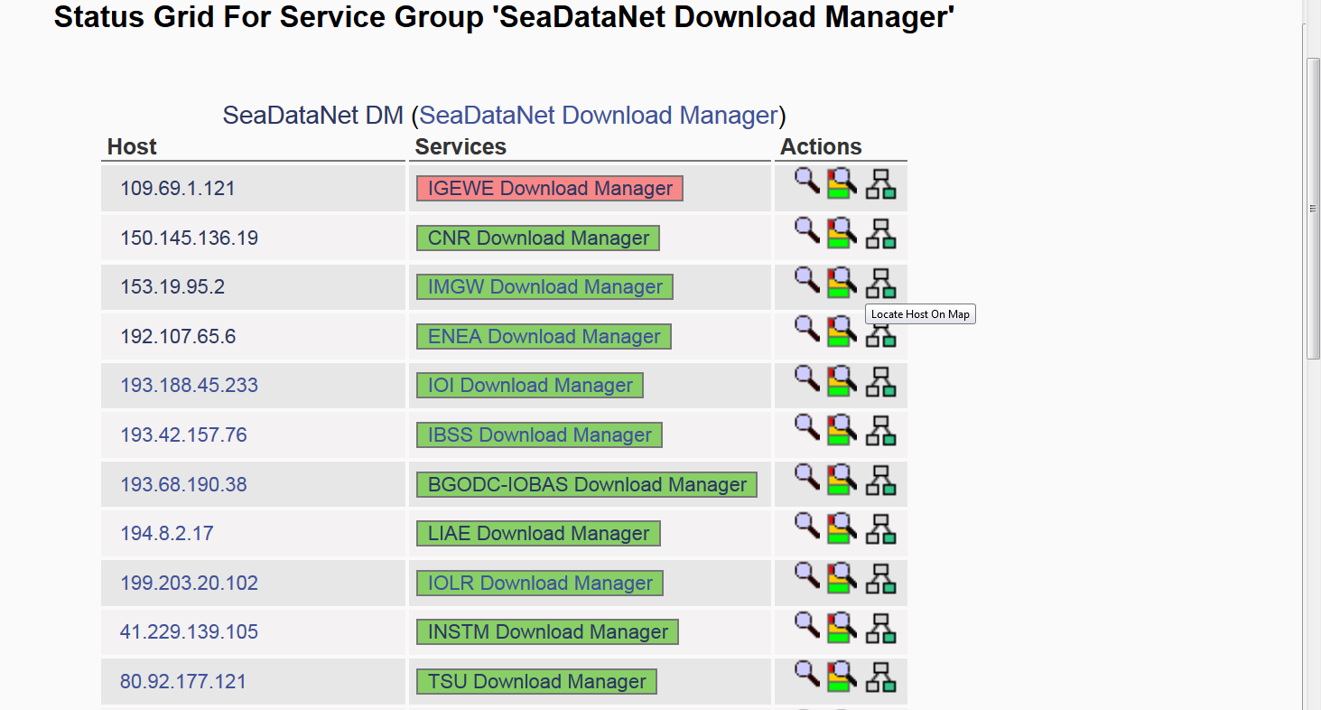
Current State -> Service Groups
Addressed to group users and categorizes the services per group.
Clicking on a service additional information about its state is displayed

Slide 12
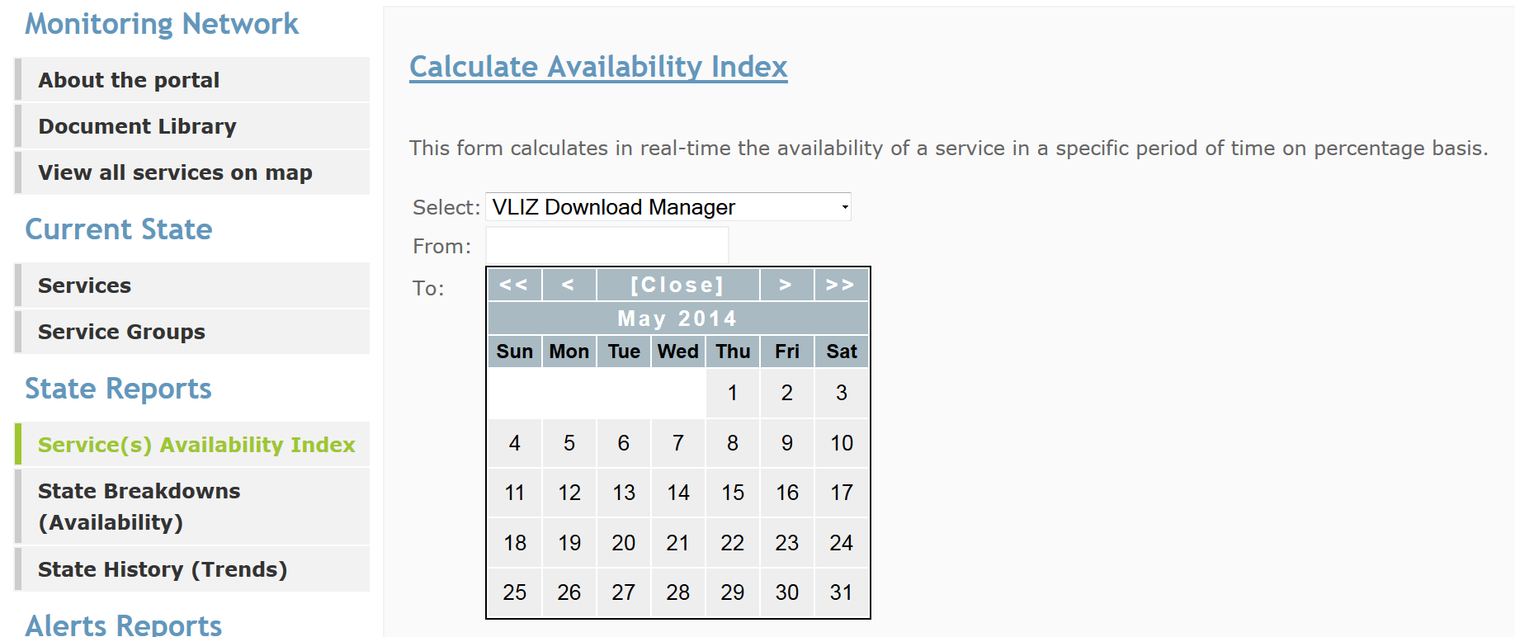
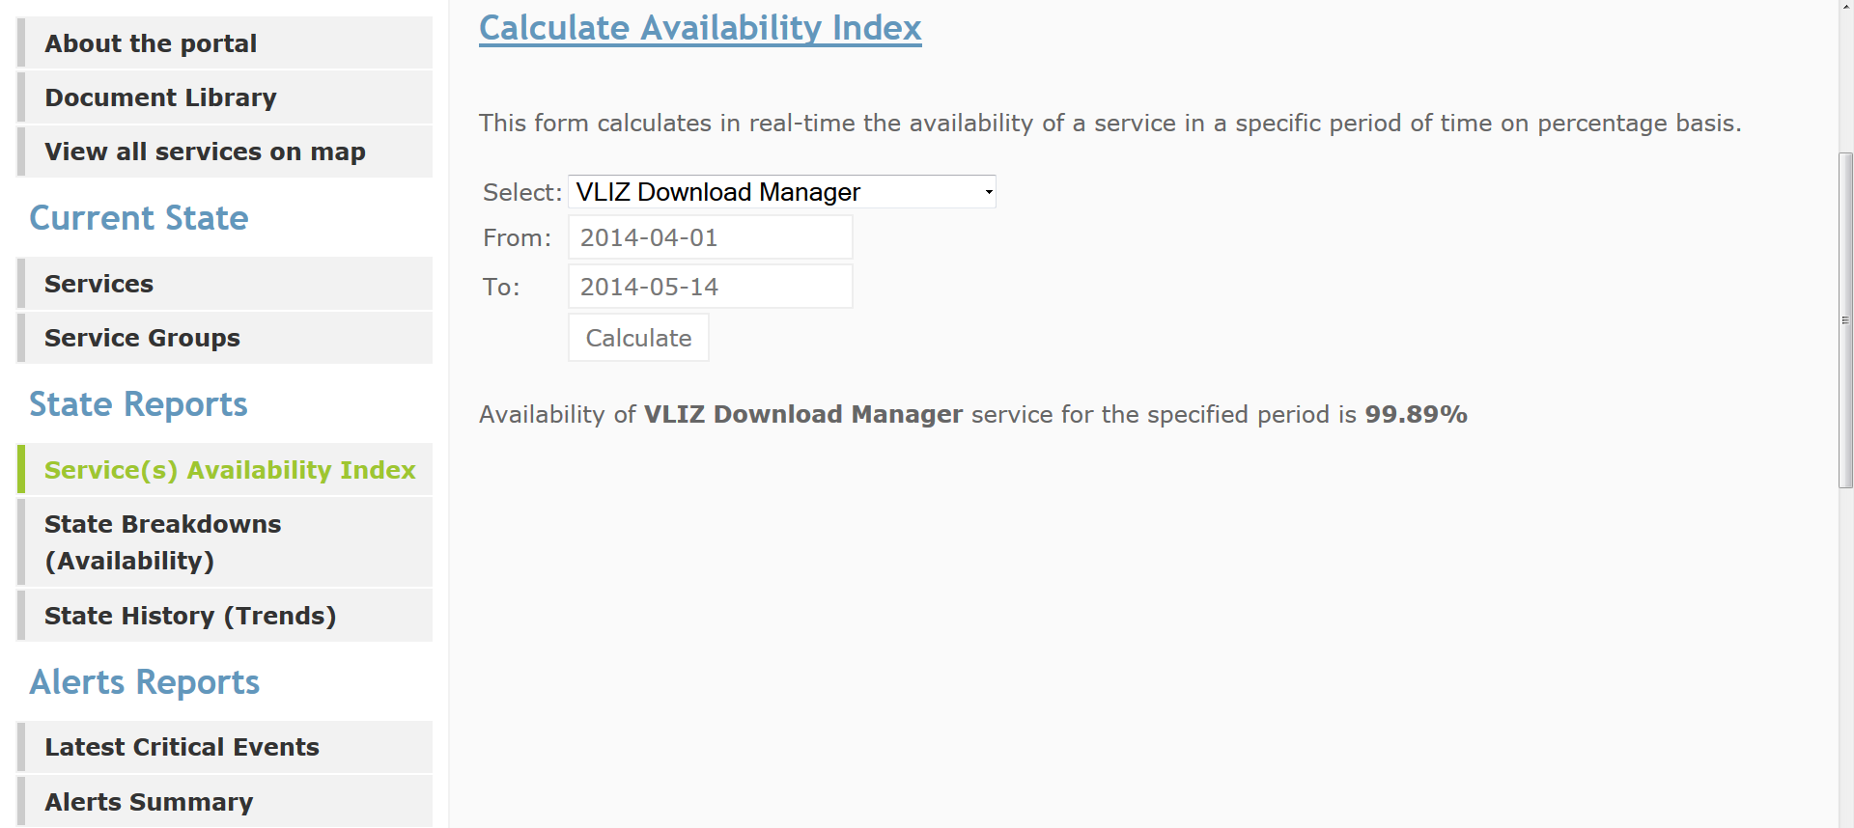
State Reports -> Service(s) Availability Index
Service Availability Index is a percentage that describes a service's uptime by indicating the service of interest and a specific period of time.
The calculated availability index is the percentage of the UP state for a single service

Slide 13
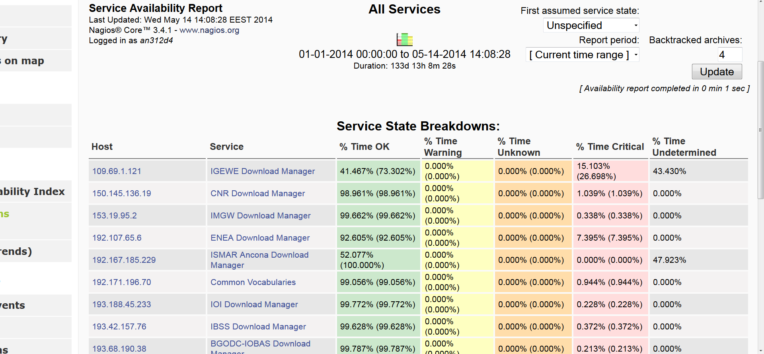
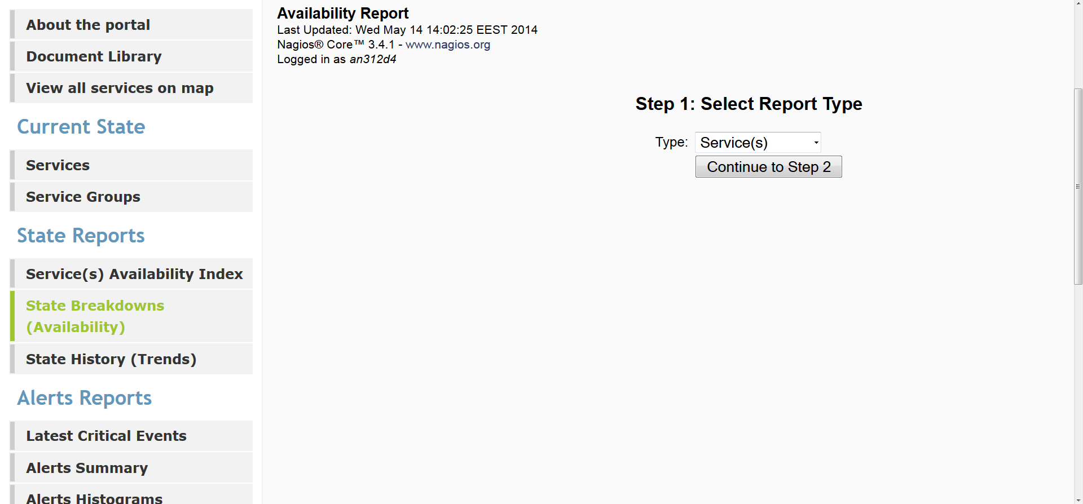
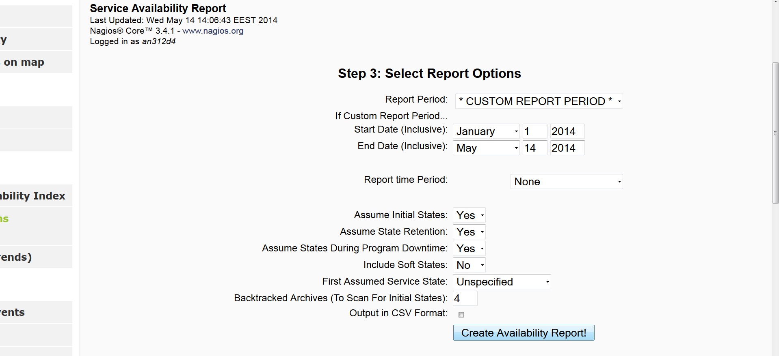
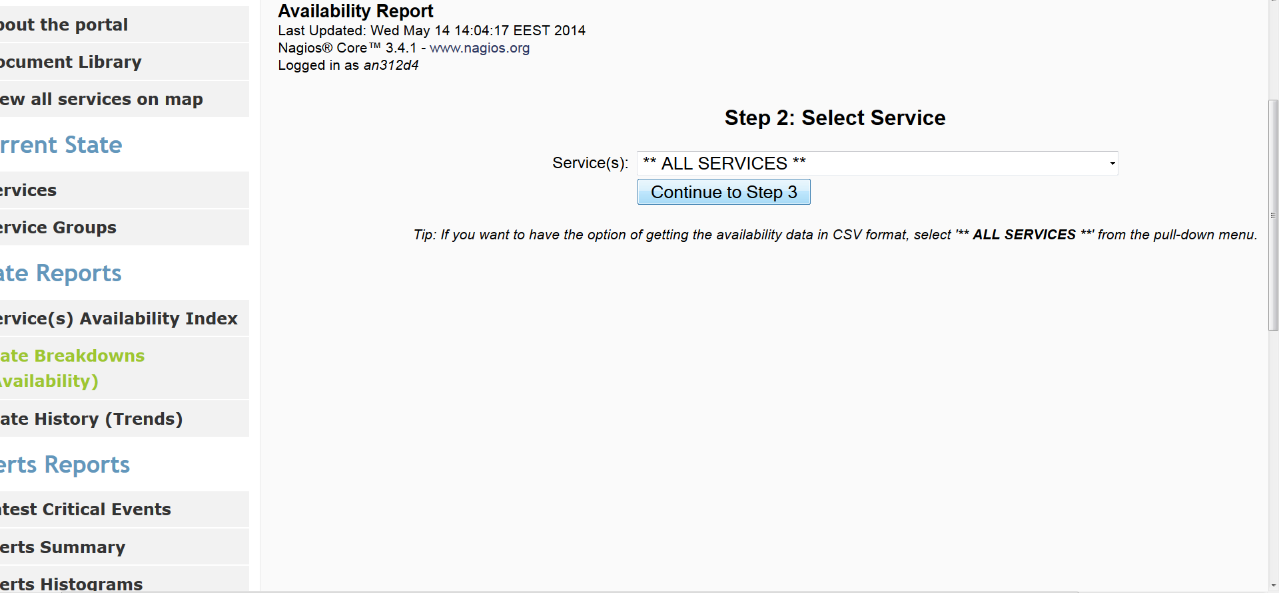
State Reports -> State Breakdowns or Availability
The Availability report displays the time frame the report covered, a table including the time period a service was at a state type as percentage and some criteria to filter the resulted table
Step3 : The final options of your report are defined here such as report period, include soft states, e.t.c.
Step2 : Select “ALL” option to view availability for all services
Step 1: Select service(s) or service groups
The Availability report describes the uptime and outages of the monitored services in terms of a percentage over a specific time period.

Slide 14
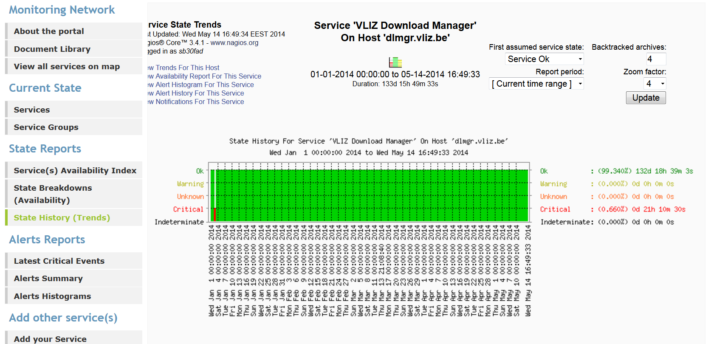
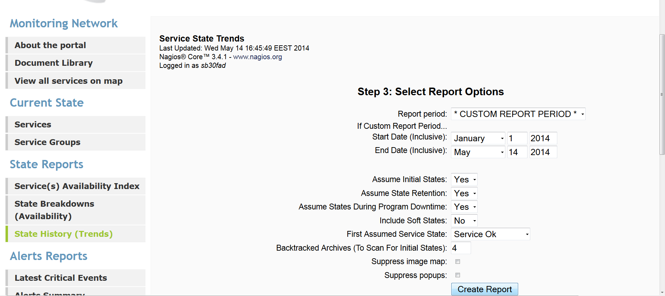
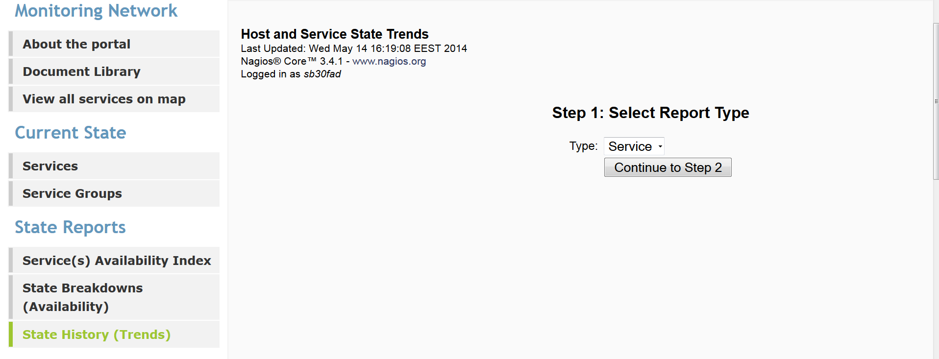
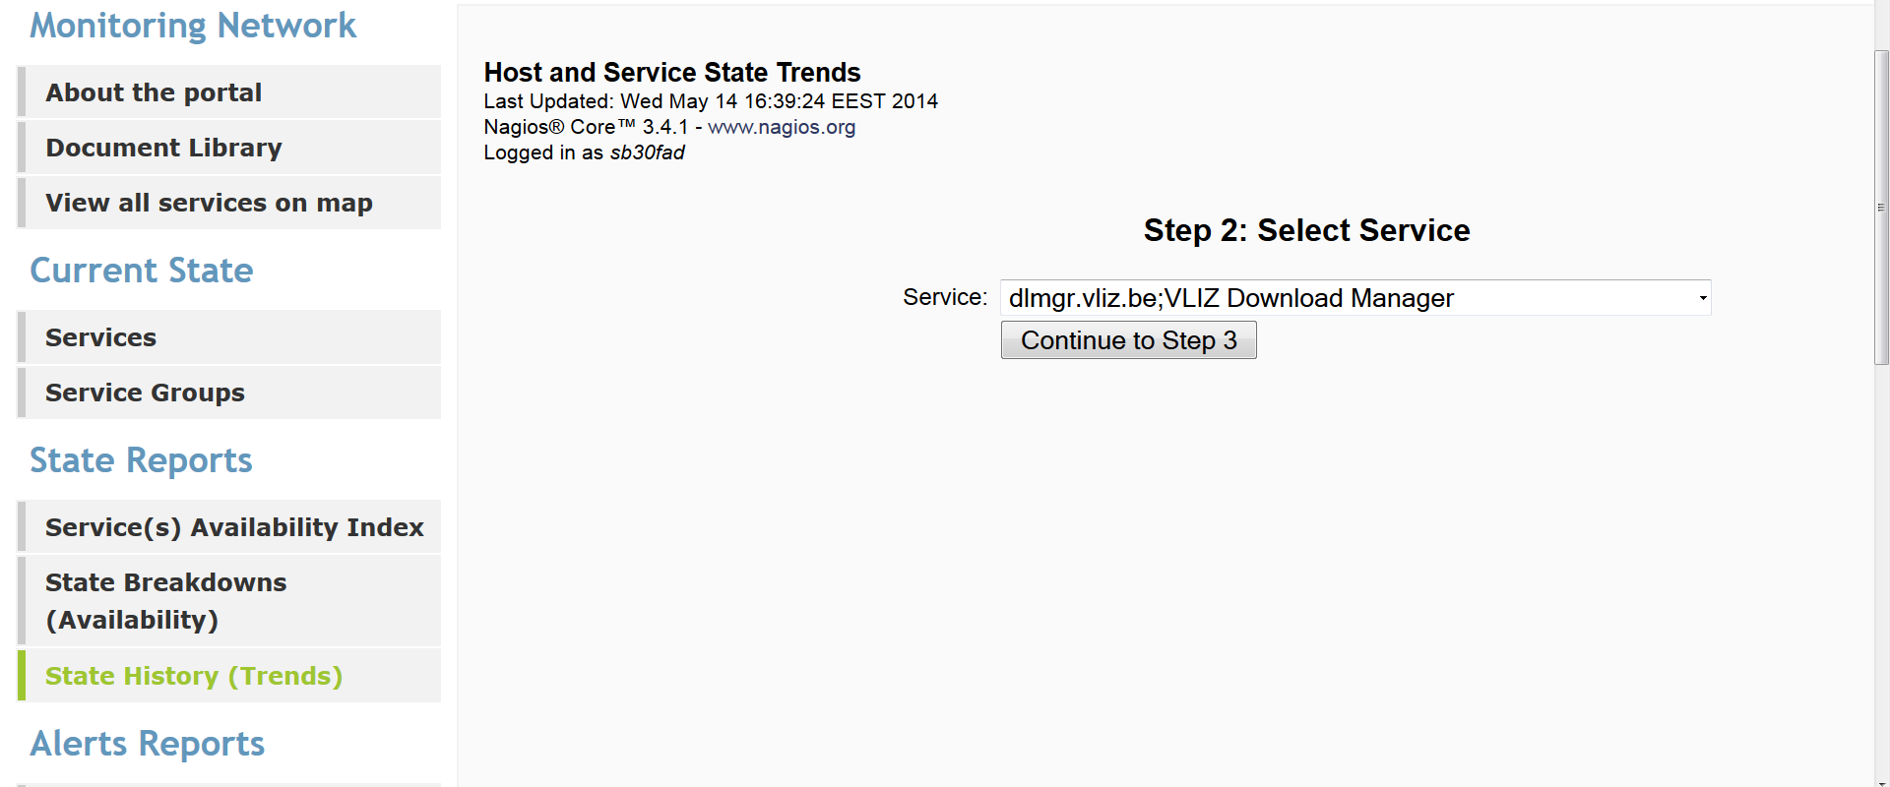
State Reports -> State History (Trends)
This graph shows the service's state over time, along with markings of time for when the state changed, and a percentage breakdown of the relative states on the right.
A healthy service might look similar to the above screenshot, with a few blips or none at all.
Step1: Select Service report
Step2: Select a service from the displayed list
Step3: Select the final options such as report period, Assume state retention, e.t.c.
n
The history of state changes for a single service is reported graphically.

Slide 15
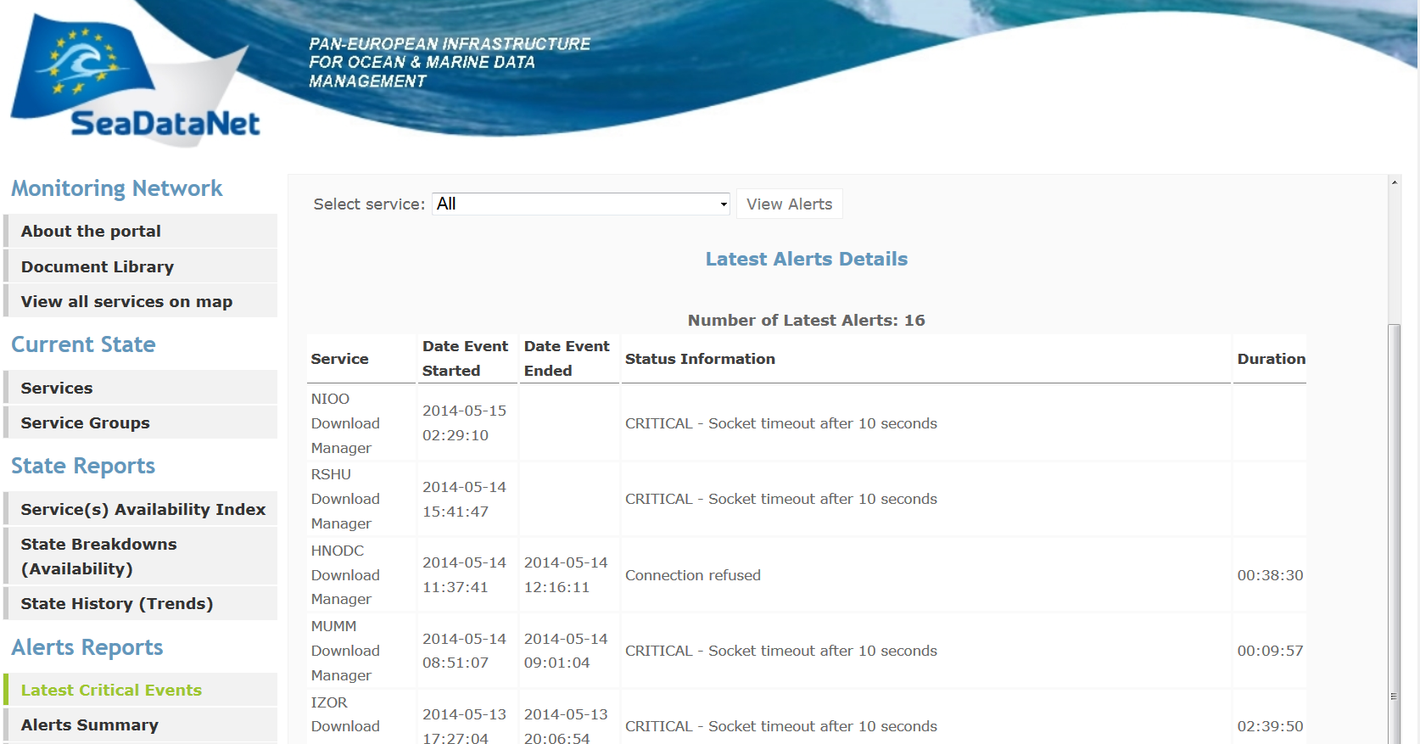
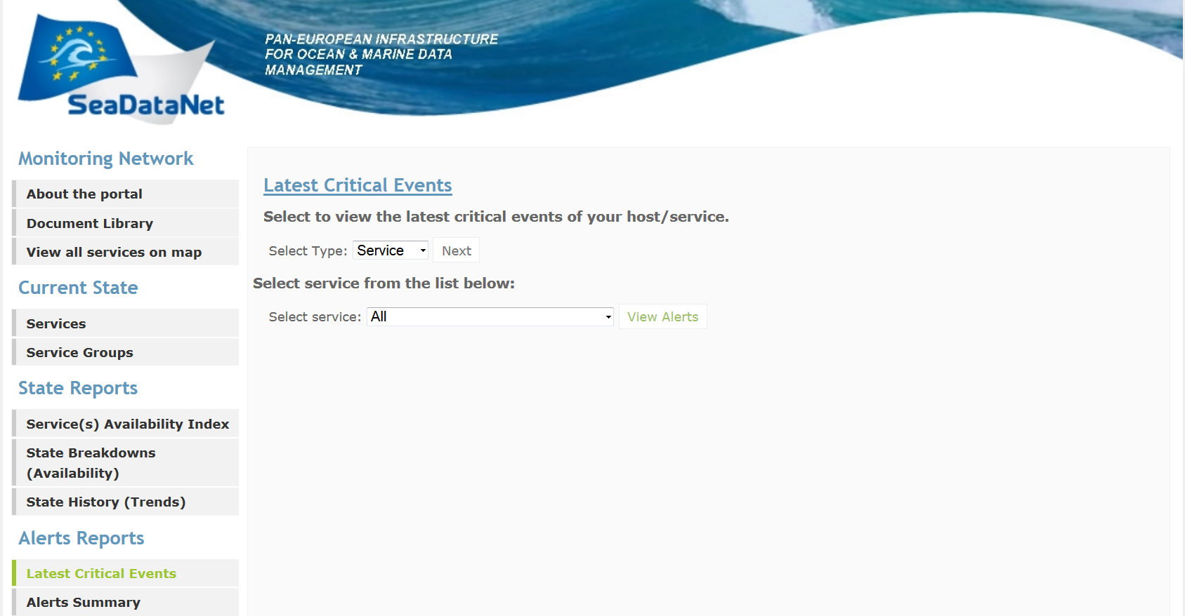
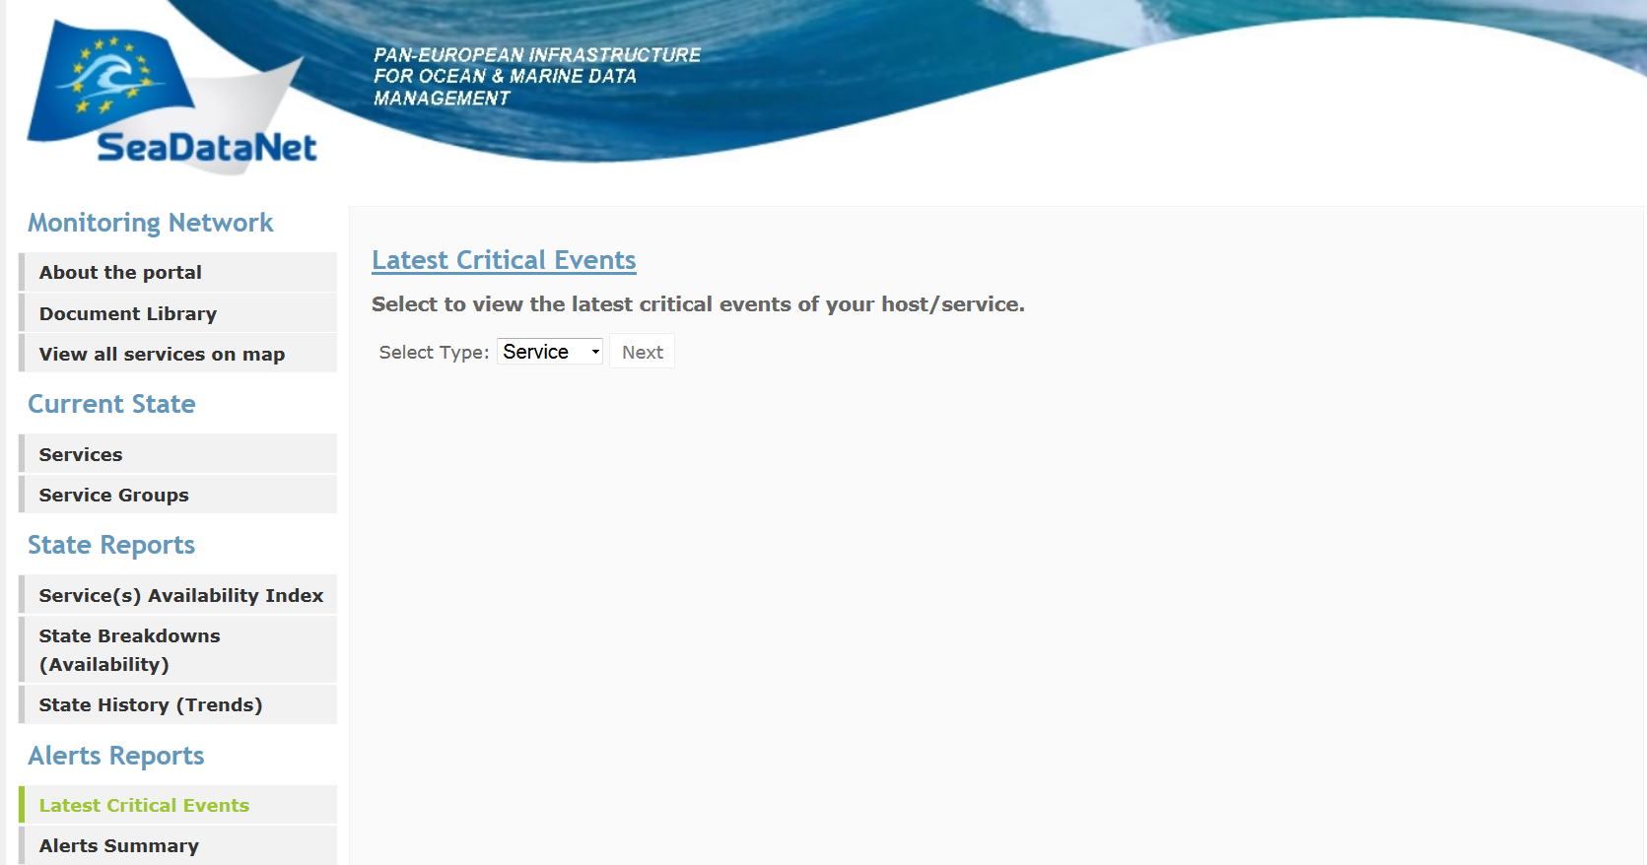
Alerts Reports -> Latest Critical Events
The latest critical events report shows:
the total number of these events
the service that was in a critical state for the last seven days
the start and end date of each recorded event
the event duration
detailed information about the cause of the event
Step 2: Select one service from the displayed list of services or the “All” option (all services)
The Hard downtime events for the last 7 days, of one or more service(s) assigned to the logged in portal user, are reported.
Step 1: Select service report type

Slide 16
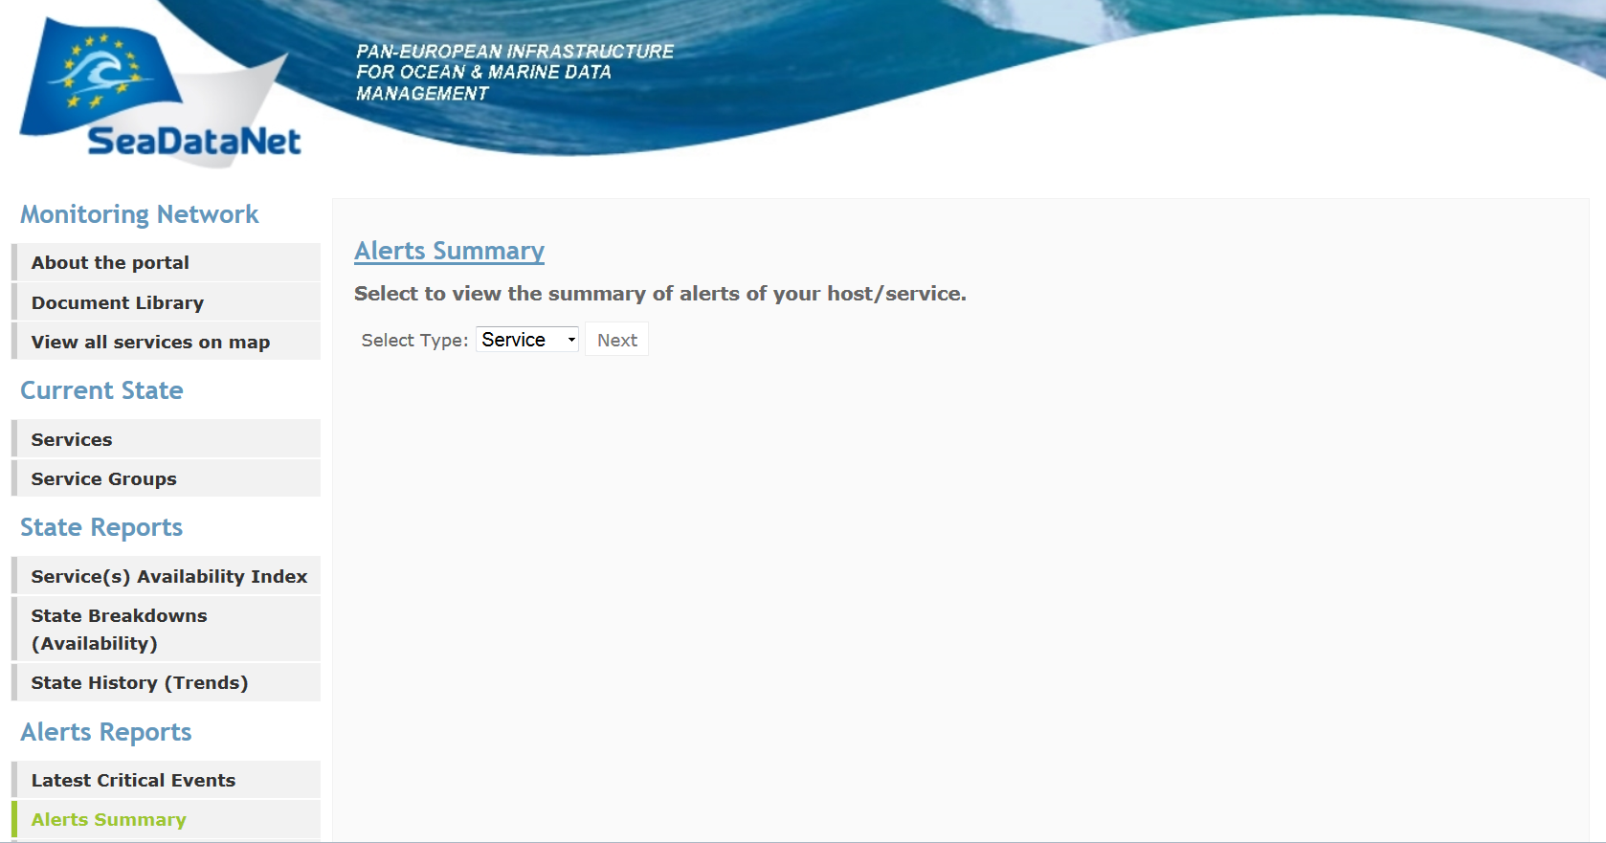
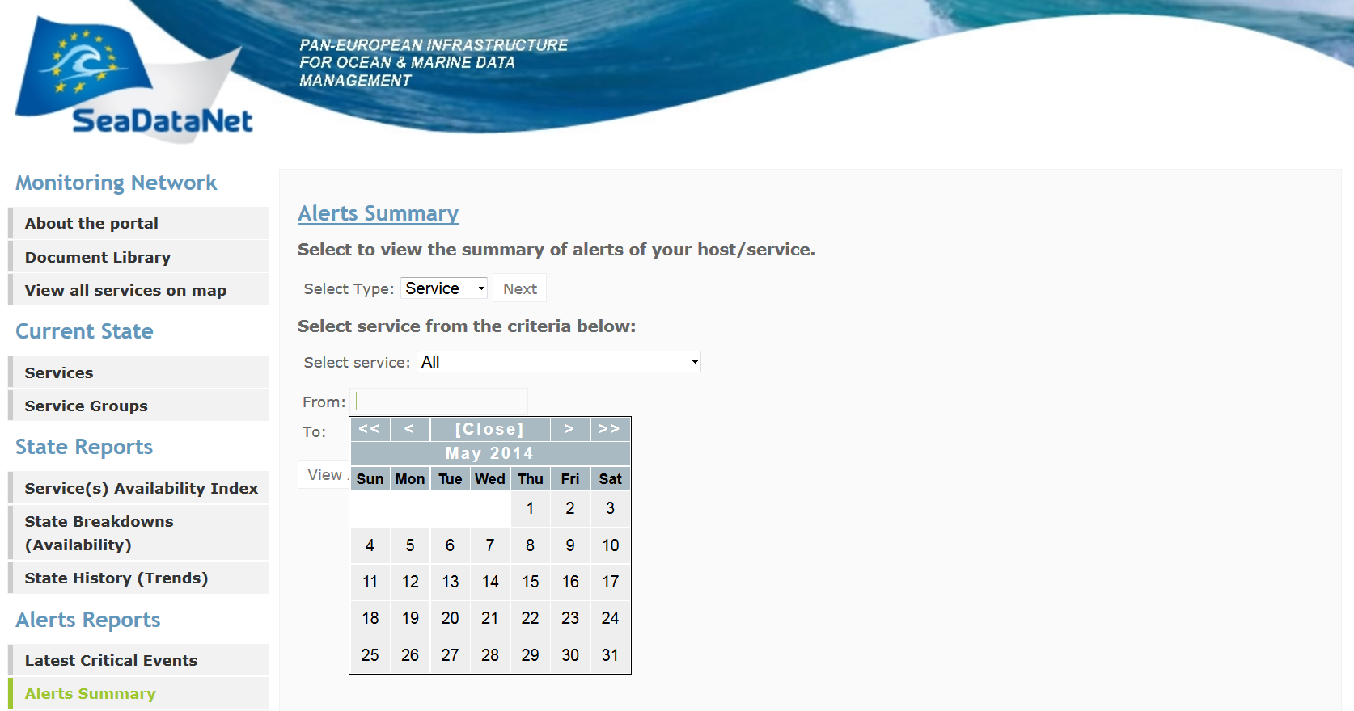
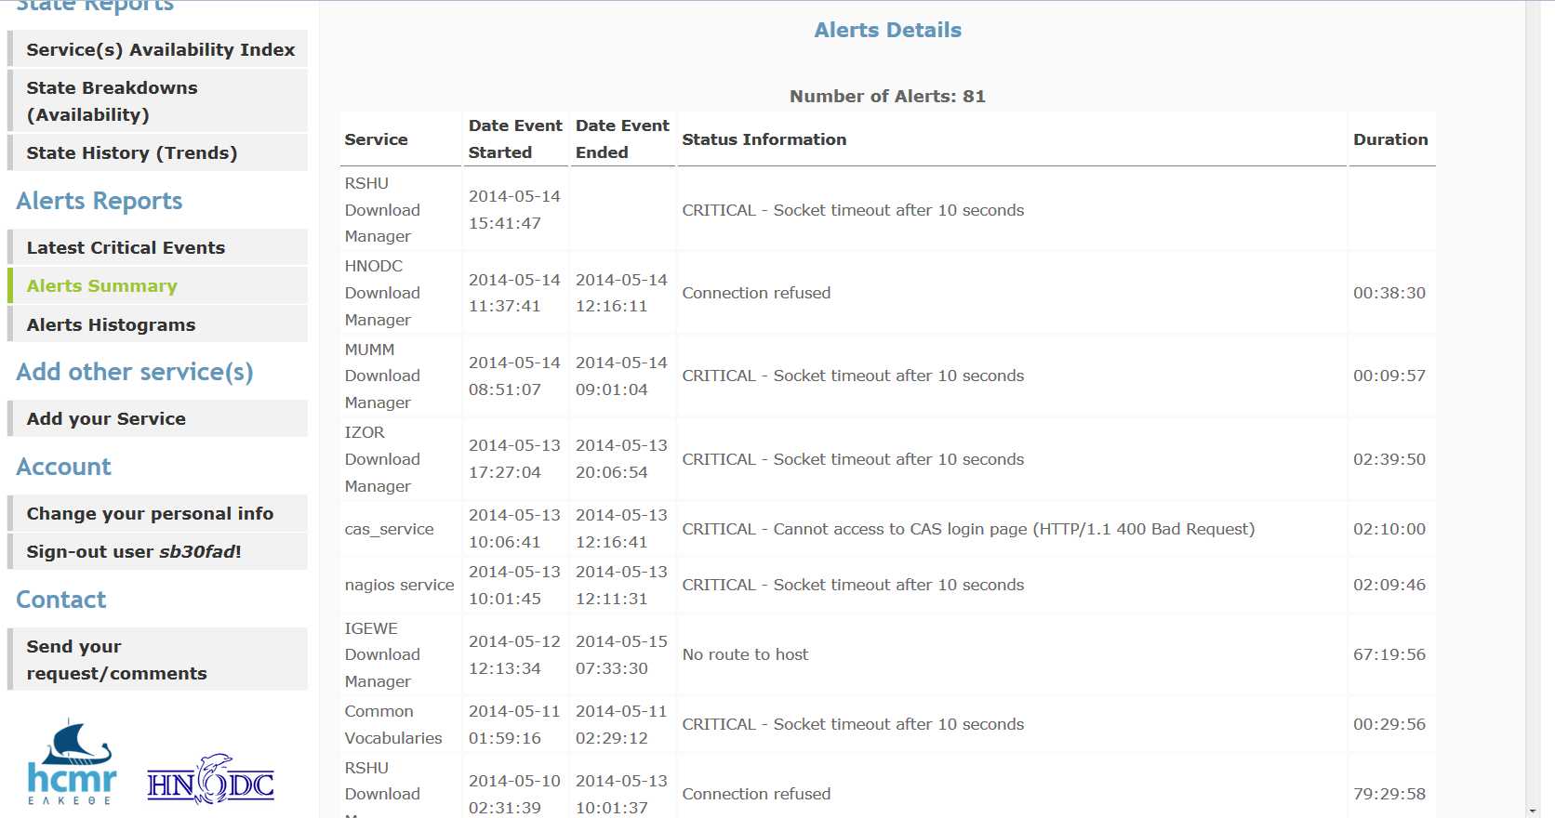
Alerts Reports -> Alerts Summary
The alerts summary report shows:
the total number critical events
the service that was in a critical state for the specified period of time
the start and end date of each recorded event
the event duration
detailed information about the cause of the event
The Hard downtime events for a specified period of time, of one or more service(s) assigned to the logged in portal user, are reported.
Step 1: Select service report type
Step 2:
Choose one service or the “All” option from the list box
Indicate the starting and end date of your report

Slide 17
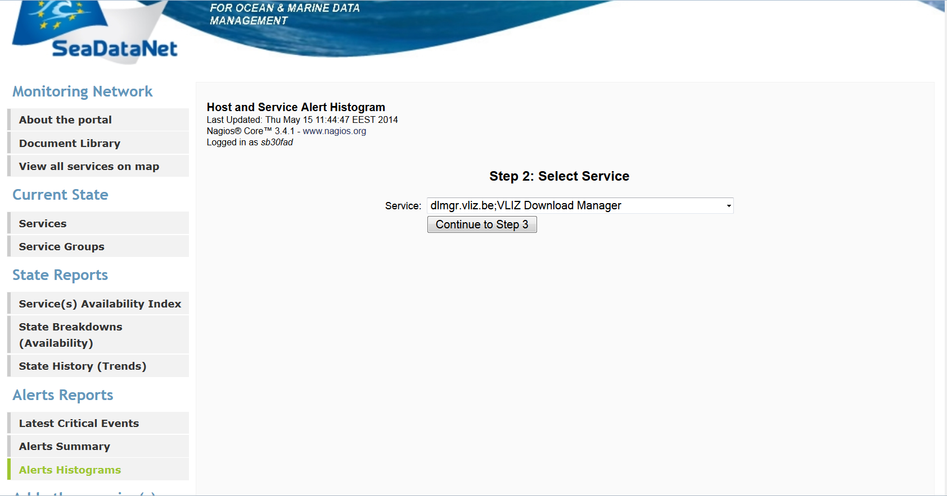
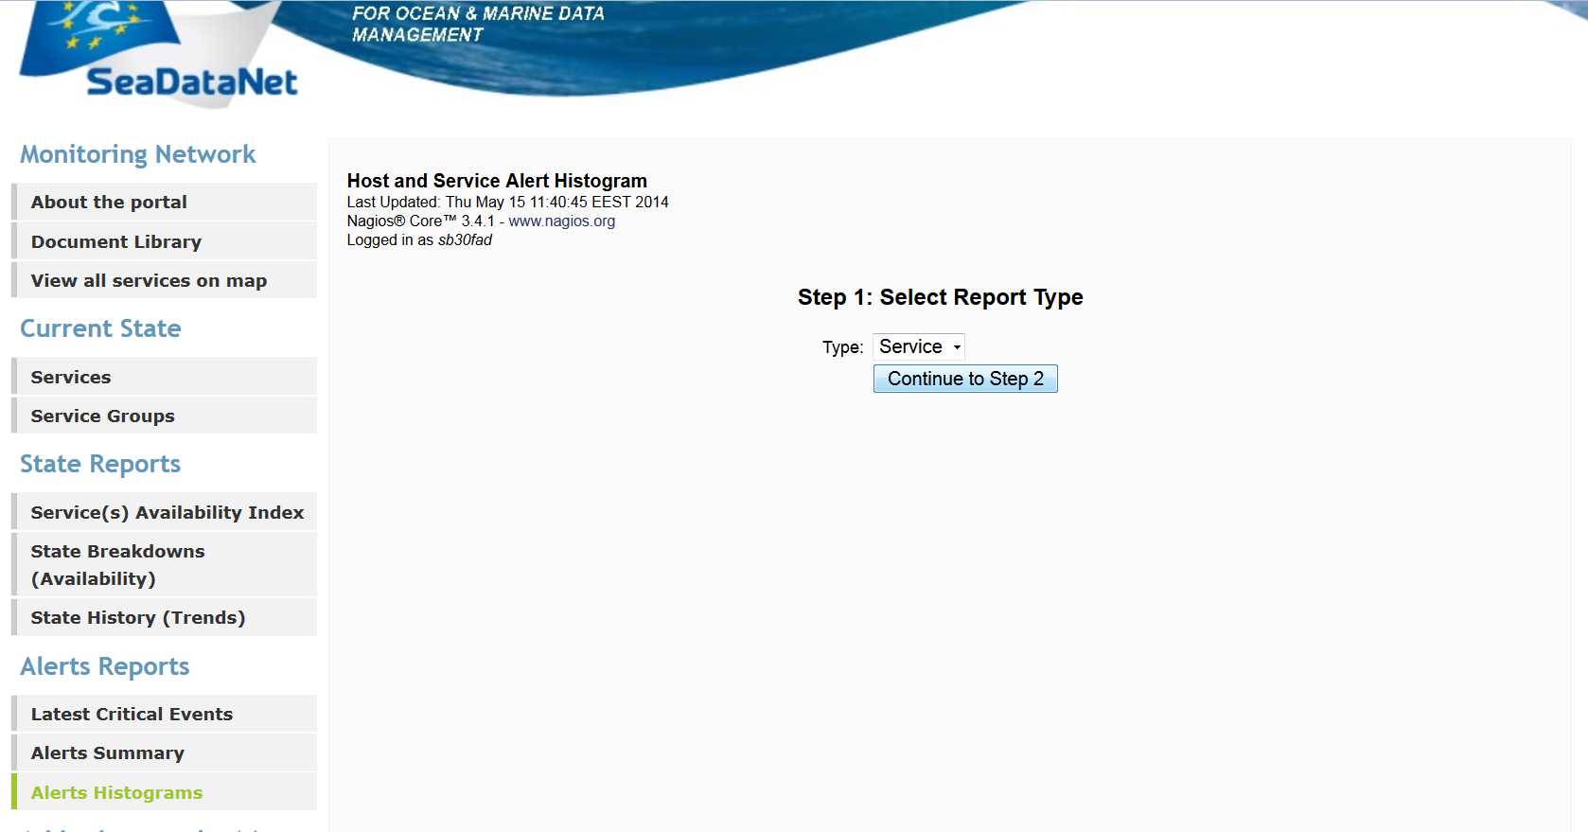
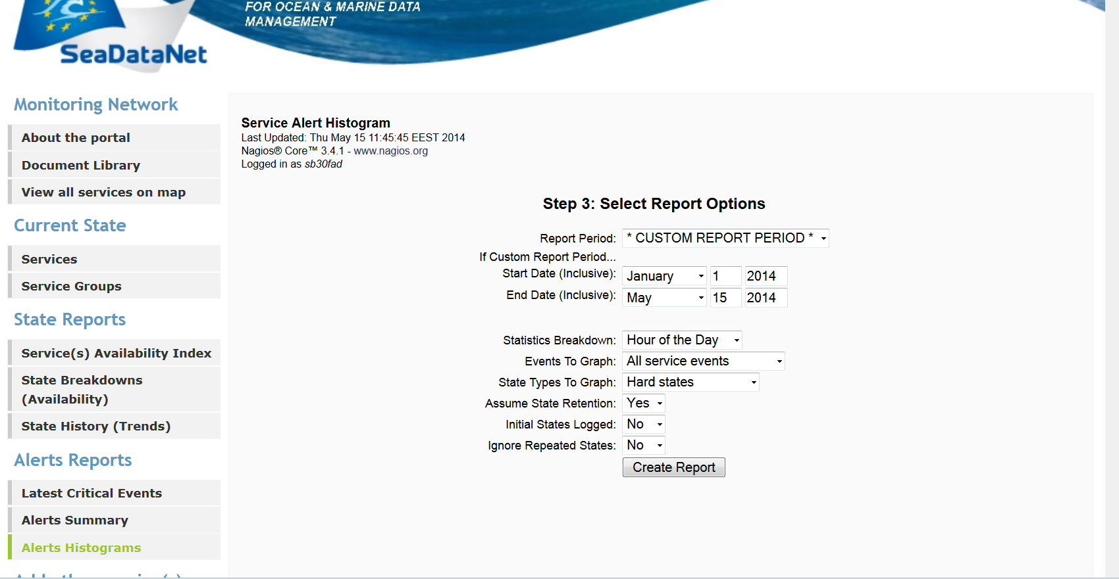
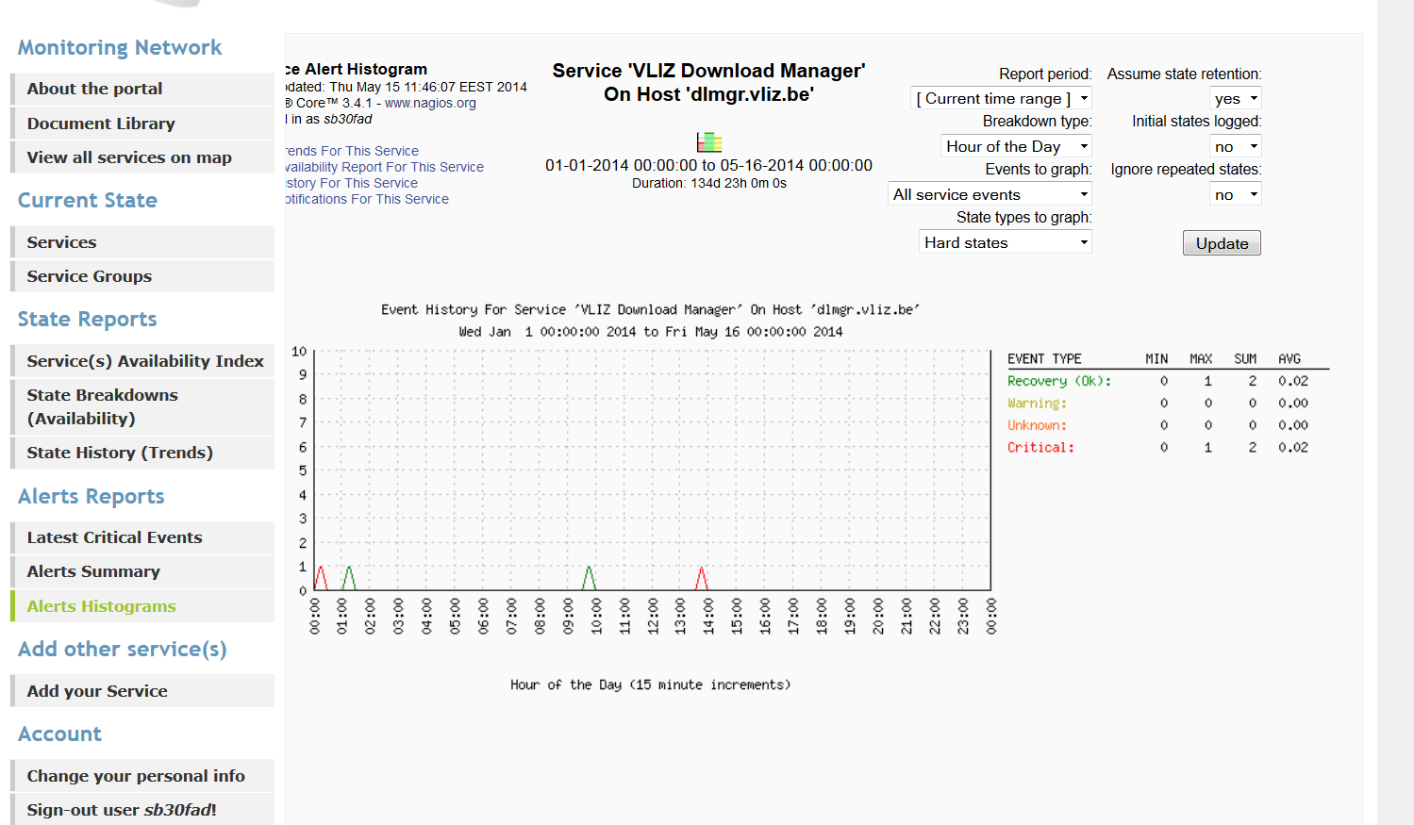
Alerts Reports -> Alerts Histograms
This report’s components are:
The variables used to configure the report, such as the time frame covered and the time taken to generate the report are displayed.
An histogram showing the service's number of events over time, along with markings of time for the types of events that occurred.
A table, on the right of the histogram, with math formulas (min, max, sum, average) for each event type is provided.
Step 3: Indicate your report ‘s time period, the events to show in the graph (OK,CRITICAL, e.t.c.), the state types (hard or soft) to include in your histogram, the statistics breakdown (frequency of the service’s status changes ), e.t.c.
Step 2: Select one service from the list of services that are assigned to the logged in portal user.
This report generates histograms showing breakdowns of the services events over a fixed period of time.
Step 1: Select service type report

Slide 18
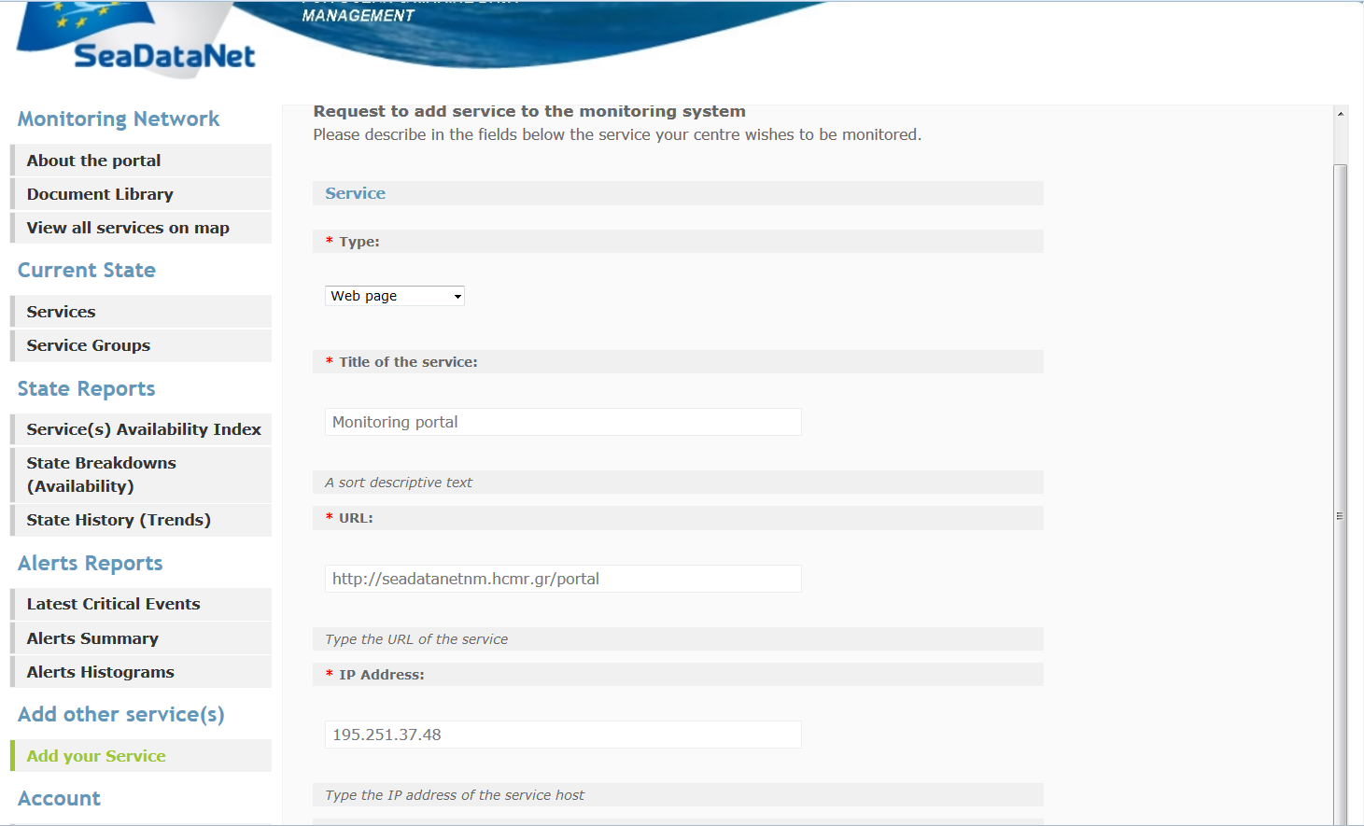
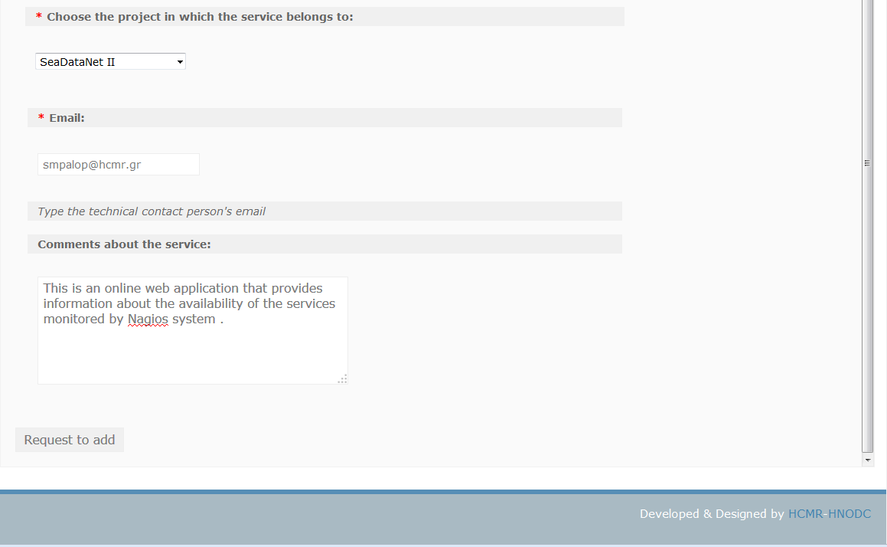
Add other service(s) -> Add your service
Request directly for a new service to be monitored by Nagios. The portal team will examine the case and will notify the user by email if and when the service will be added to the system, and therefore can be viewed by the portal interface.

Slide 19
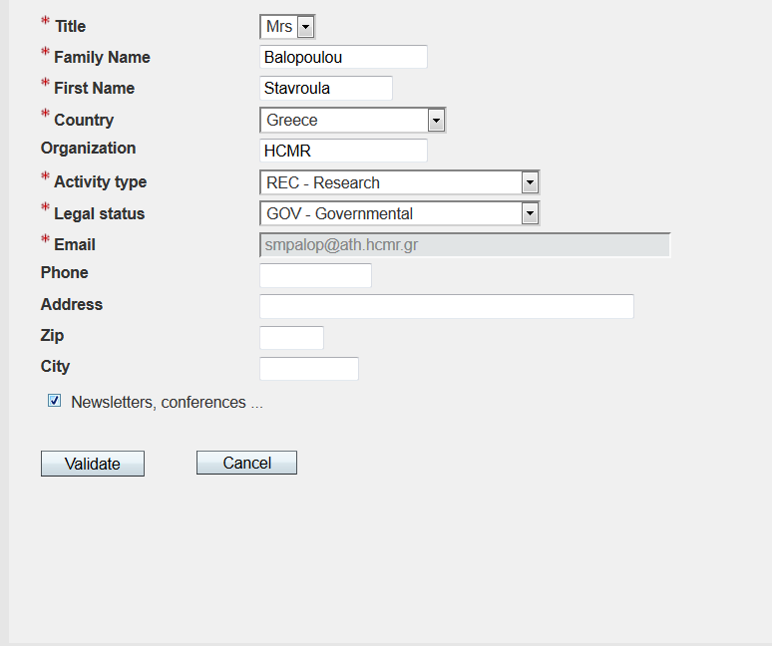
Account
Change your personal info page
Logout

Slide 20
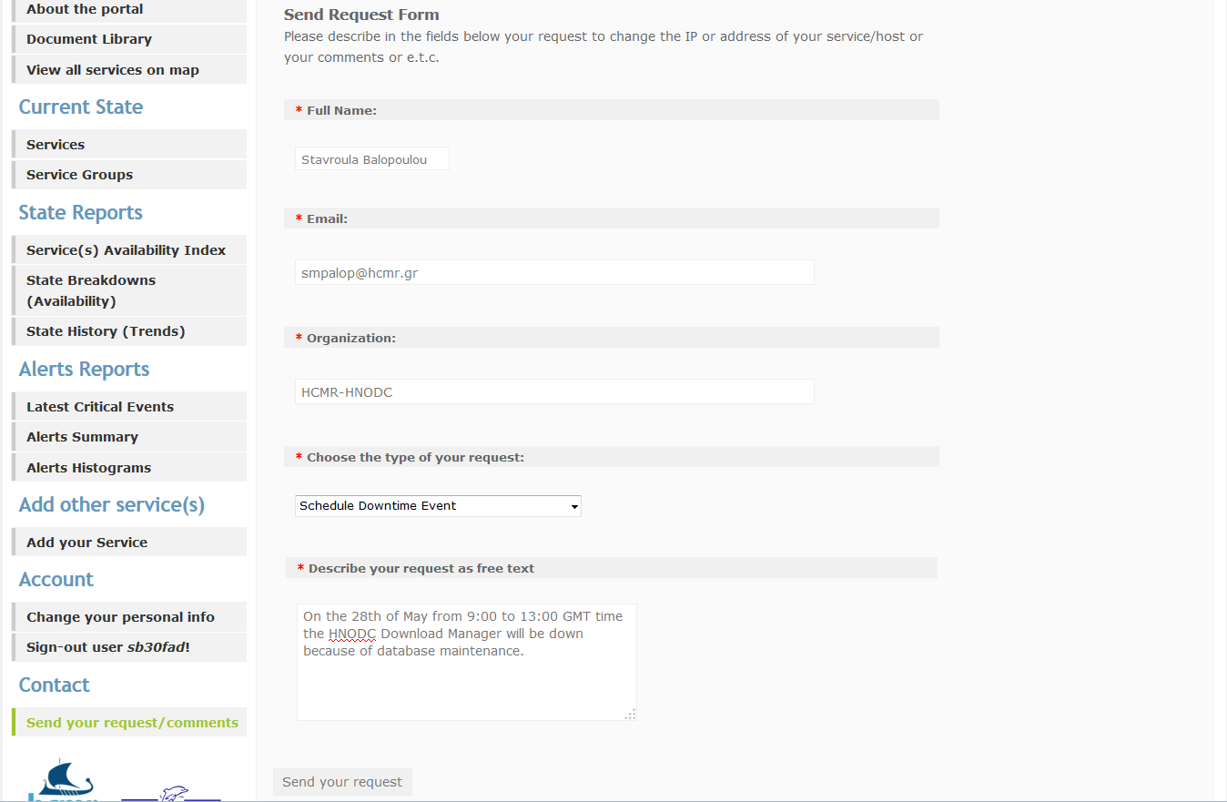
Contact -> Send your request/comments
Portal users can send their requests for:
changing the IP or address of service
scheduling downtime events
making comments
other

Slide 21
Planned portal changes
Confirmation that any request you made through the portal’s “Send your request/comments” capability is sent to the monitoring team
Addition of Download Manager’s installed version in the list of local monitored services
A user manual for the Monitoring Portal will be available soon at the portal’s Document Library

Slide 22
Thank you!

