Slide 1
GML in CDI and CSR ISO 19139 using Ends&Bends
V. Tosello, IFREMER

Slide 2
GML in CDI and CSR
GML = Geography Markup Language
To detail the geographical features of tracks and polygons in conformity with the real geographical coverage
Thanks to position lists, GML allows to describe:
tracks or surfaces in CDI
Only tracks in CSR
In CDI, multiple points are not used, because each point measurement is considered as object for an individual CDI record. The location of a single measurement point is then already described by filling in the Bounding Box
POINT
LINE/MULTILIGNE
POLYGONE/MULTIPOLYGONE
Notes:
This enables to describe in CDI V1 format also hydrographical and seismic surveys

Slide 3
GML for CDI and CSR – Recommandation
IMPORTANT: We strongly recommend you not to use your navigation files as position lists, but to subset them and to use only a reduced (but representative) part of them.
Typical navigation log files record more than one location / 10 seconds (ex : GPS outputs),
Size of these navigation log files are not practical to be managed or visualized using standard GIS software or services (WMS, WFS,…)
Navigation log files must be subset, but sub setting must :
Keep the same geographical shape of the vessel route to allow accurate spatial queries
Reduce significantly the number of geographical locations to preserve response time (e.g. 1000 points for one month of deep sea navigation, 1000 points for a week of inshore navigation)
Use EndsAndBends software to reduce your position list (algorithm for track schematisation)

Slide 4
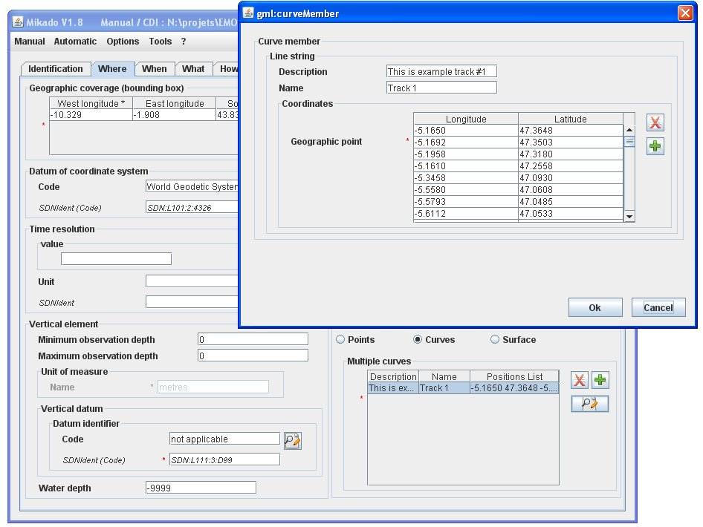
GML in CDI/CSR – MIKADO manual
Detailed description of the geographical location of each measurement point, track or area
GML extension is represented by a table containing as many lines as curves/surfaces
For each track or area: Description, Name, Latitudes, Longitudes (positions list)

Slide 5
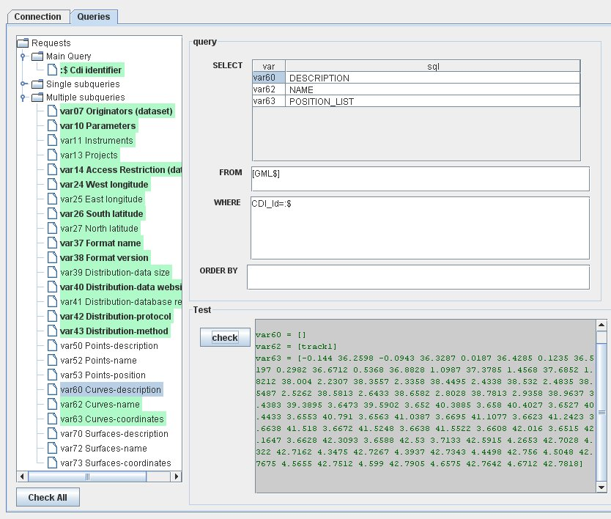
GML in CDI/CSR – MIKADO automatic
GML is represented by the variables (60, 62, 63) for Multicurves and (70, 72, 73) for Multisurfaces in Multiple queries
For point (only in CDI), use the Bounding box (var24 to 26)
Description, name and positions list
One line for one curve/surface and the coordinates of the curve/surface position must be filled in as Longitude1 Latitude1 Longitude2 Latitude2 etc…

Slide 6
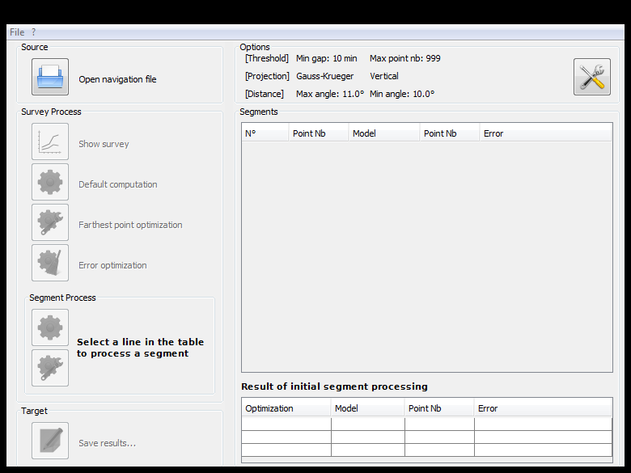
GML in CDI/CSR – Ends&Bends
Ends&Bends is used to sample raw navigation files (ship routes) and to generate spatial objects that can be included in:
CDI records to describe the geometries of the observations
CSR records to describe the cruise track

Slide 7
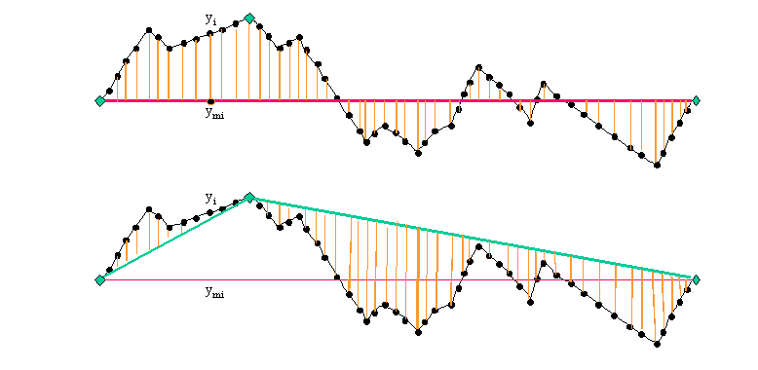
Ends&Bends - Algorithm
Ends&Bends keeps the first and last point and add iteratively points to minimize the square of the distances from the route locations to the straight line
Ends&Bends stops when (user’s choice)
the square of distances is below the fixed limit
the maximum number of points to be kept is reached
Notes:
Used at IFREMER for geophysical data
Algorithm for track schematisation
-> From navigation file containing GPS positions
-> List of coordinates defining a survey line
Ends and bends only to reduce storage requirement.

Slide 8
Ends&Bends - Technical characteristics
Standalone application
Written in Java Language (Version >= 1.6)
Available under multiple environments (Windows, Unix, Linux).
Software freely downloadable on SeaDataNet website
http://www.seadatanet.org/standards_software/software/ends_and_bends
Installation manual and user manual also available on SeaDataNet website (same webpage)
User’s manual and online support included (Menu “Options/Help”)

Slide 9
Ends&Bends main capabilities
Supported input formats (navigation log files)
Column Text File (Comma Separated Values, …)
NetCDF .nvi (French vessels)
UKOOA P1-90
Supported output formats
Shape files (ESRI/GIS standard)
GML (Geography Markup Language)
WKT (Well-known text)
Comma Separated Values (User defined)
CDI XML Files (e.g. generated by Mikado)
To be loaded in a relational database with GIS facilities and then used by Mikado (Oracle, PostGIS, SQLServeur, MySQL, …)
To add directly geometry (GML) in the CDI record

Slide 10
Metadata
in
Database
MIKADO
Metadata
Input
XML
Metadata
Files
CDI
Insertion in metadata database prior CDI generation
SEADATANET
PORTAL
Insertion in pre-existing CDI files
CSR
Navigation file
Ends&Bends

Slide 11
Ends&Bends – Usage
4 STEPS
Define the input file and its format, some user’s inputs are mandatory to read the file e.g. column for latitude, column for longitude, … in case of CSV
Launch the sub setting process
Control the result (accuracy, number of kept points, map)
Save the result in an output file (choosing the output file format)
Notes:
Optionally define the portions of route to be considered (using date/time) (e.g. one or several transects within the full cruise)

Slide 12
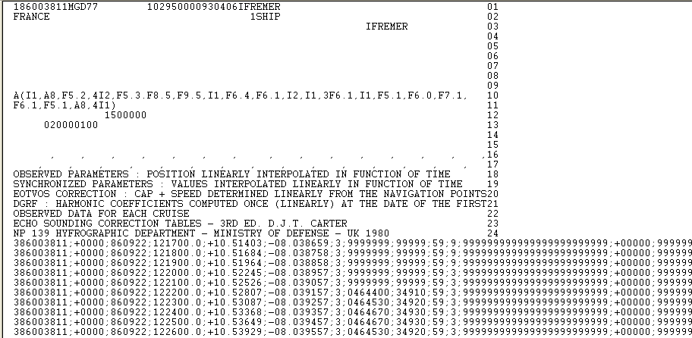
Example : Generation from CSV file
Date : YYMMDD
Time : HH24MISS
Header to be skipped
Latitude : +DD.ddddd
Longitude : +DDD.ddddd

Slide 13
Step 0 : Run Ends&Bends Software

Slide 14
Step 1a – Open the input file

Slide 15
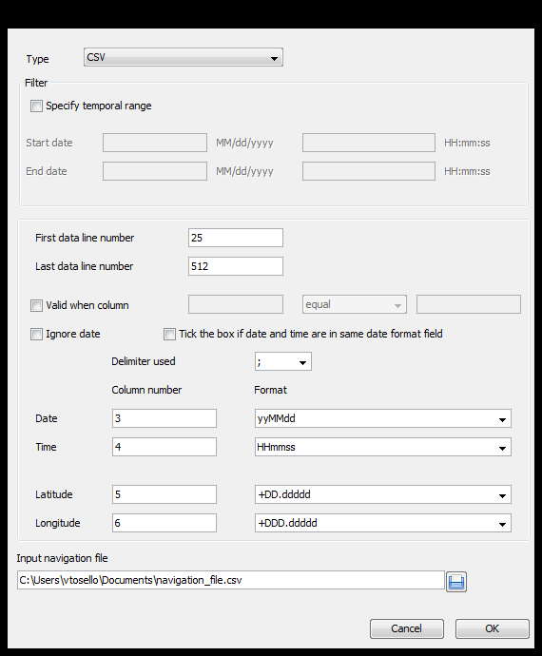
Step 1b - Define the input format (ex: CSV)
File format
Filter on date/time
First data line number (to skip the header)
Last data line number
Filter on parameter value
Column numbers and formats for date, time, latitude, longitude
Input file name

Slide 16
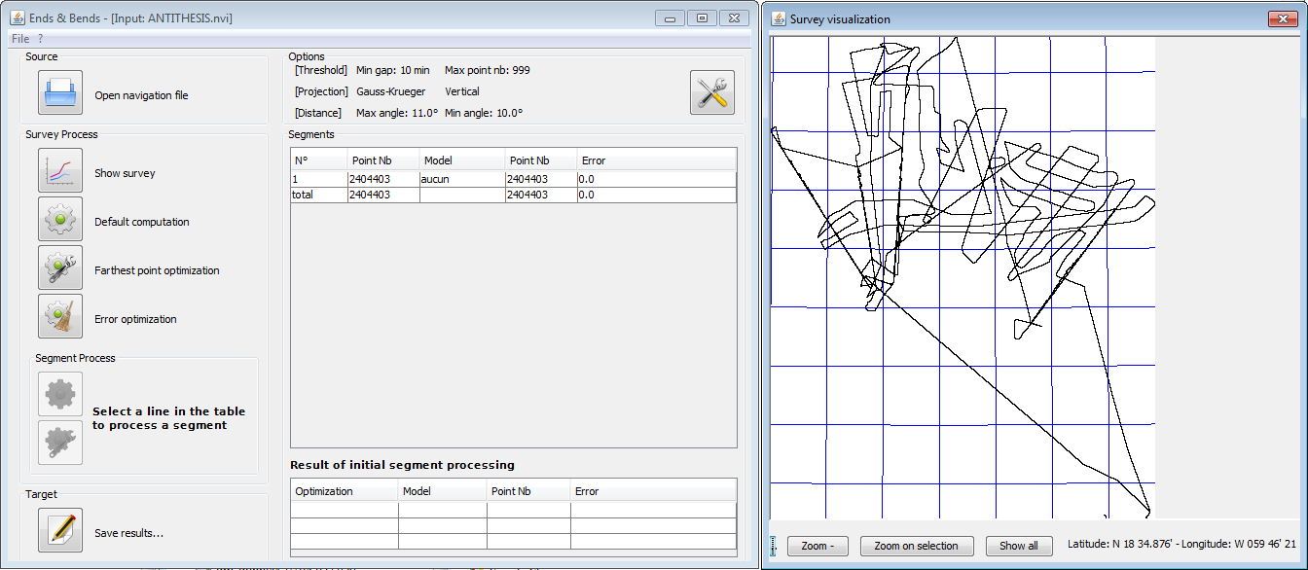
Step 1c – Visualization of the input navigation file

Slide 17
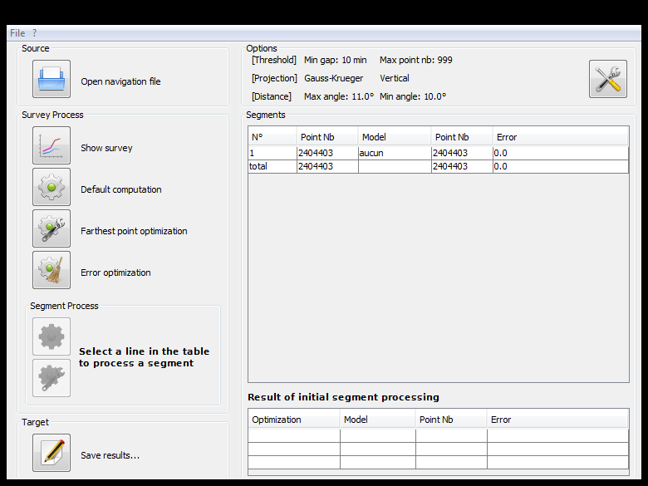
Step 2a . Launch the sub-setting

Slide 18
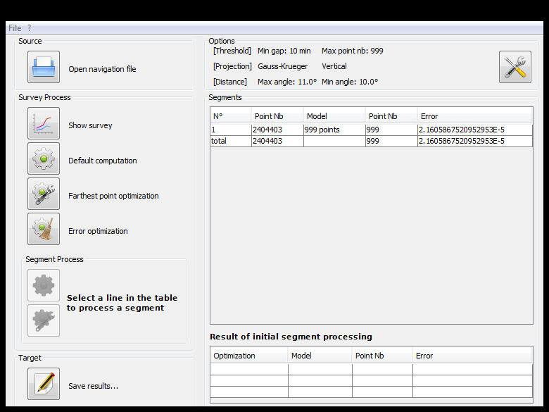
Step 2b . Result of the sub-setting
Number of points in input
Error level
Model of optimization (can be changed)
Number of points in output

Slide 19
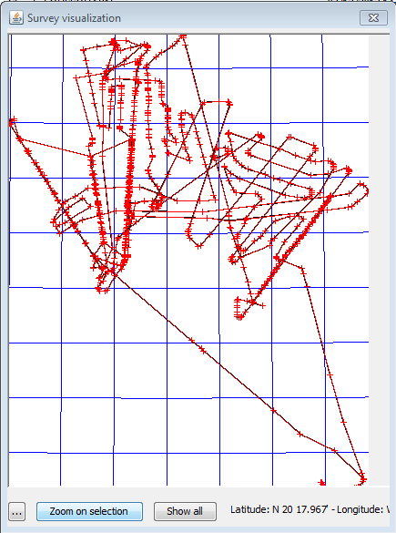
Step 3 . Control and visualization of the result (map)
Points kept in output file

Slide 20
Step 4 . Save the result (e.g. CDI record file)

Slide 21
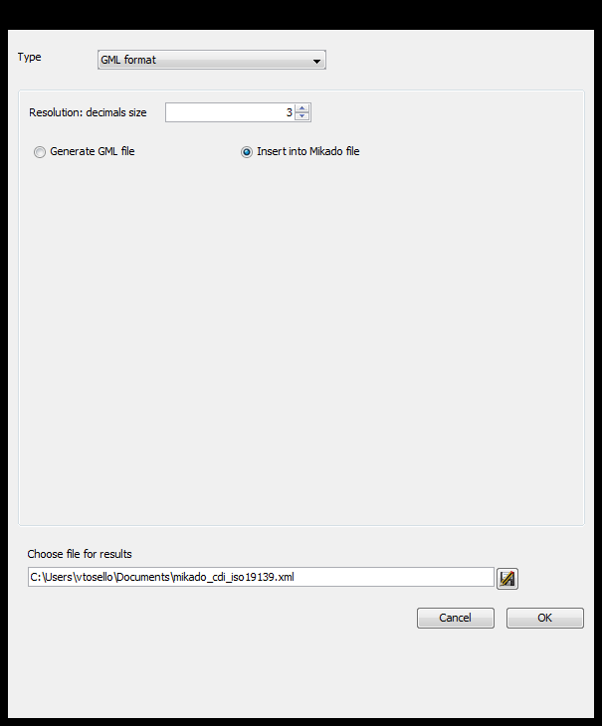
Step 4 . Save the result (in CDI or CSR XML file)
File Type
Insert GML into a pre-existing CDI or CSR ISO 19139 XML file

Slide 22
Practical work: « EndsandBends » folder
Follow the 4 previous steps using:
navigation_ascii.csv : navigation file (CSV format)
CSR_ISO19139_11010060_without_gml: CSR ISO 19139 XML file without GML

Slide 23
QUESTIONS?

