Slide 1
MIKADO: Generation of CDI ISO19139 XML files
V. Tosello, IFREMER

Slide 2
Overview
What’s Mikado ?
What’s new in MIKADO 3?
Description of CDI ISO 19139
How to create and update CDI ISO 19139 XML files?
Mikado manual
Mikado automatic
How to validate my CDI files?
Practical work

Slide 3
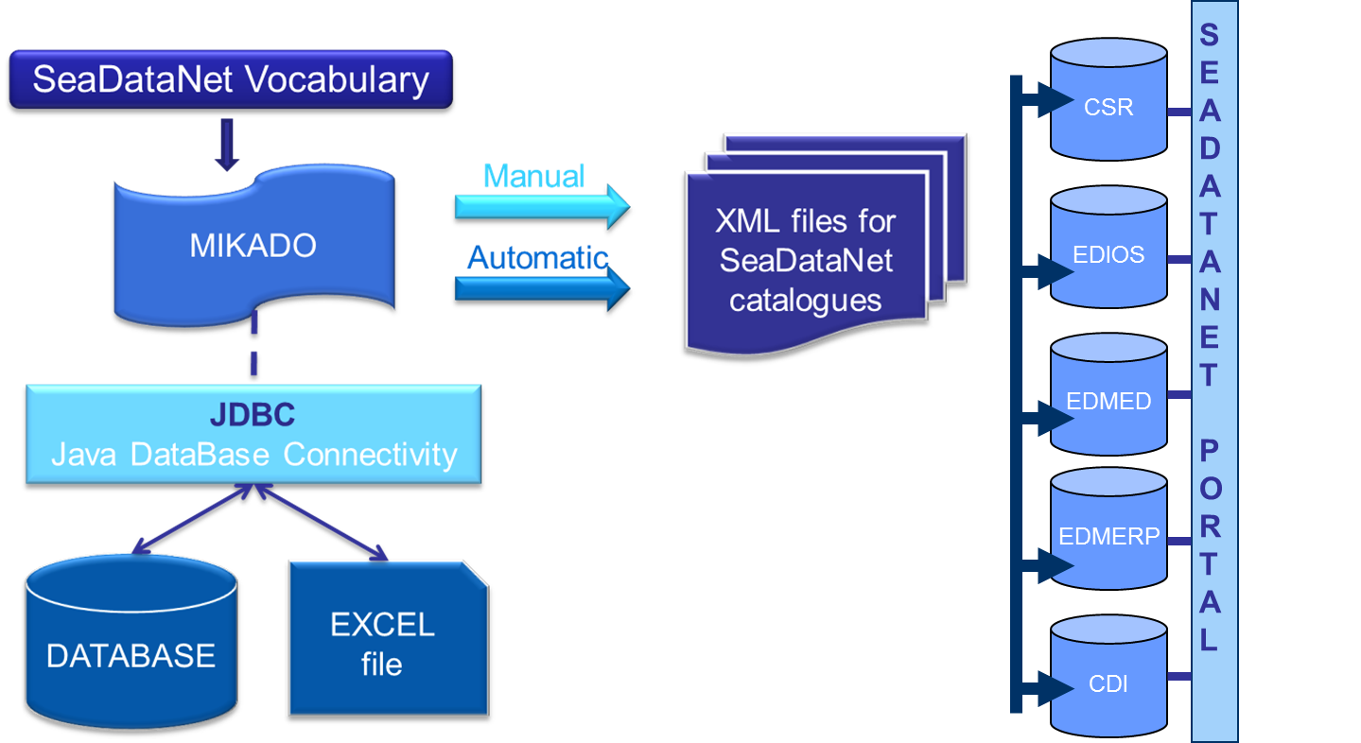
What’s MIKADO ?
Tool for the generation of XML descriptions of SeaDataNet catalogue records (CSR, CDI, EDIOS, EDMED, EDMERP)
Notes:
As you certainly already know, MIKADO is used to generate XML descriptions for the following SDN catalogues.

Slide 4
What’s new in MIKADO 3?
Migration to NVS 2.0 BODC vocabulary
Migration to INSPIRE compliance (CSR and CDI ISO 19139)
Notes:
In the framework of the first innovation cycle, MIKADO has been upgraded in order to take into account :
Migration to new NVS 2.0 of common BODC vocabulary
Change of sea areas vocabulary list
Migration to INSPIRE compliance (ISO 19139)
On en a profité pour … Improvements (Fixed bugs, New functionnalities)

Slide 5
What’s new in MIKADO 3?
Migration to NVS 2.0 BODC vocabulary
Migration to INSPIRE compliance (CSR and CDI ISO 19139)
Notes:
In the framework of the first innovation cycle, MIKADO has been upgraded in order to take into account :
Migration to new NVS 2.0 of common BODC vocabulary
Change of sea areas vocabulary list
Migration to INSPIRE compliance (ISO 19139)
On en a profité pour … Improvements (Fixed bugs, New functionnalities)

Slide 6
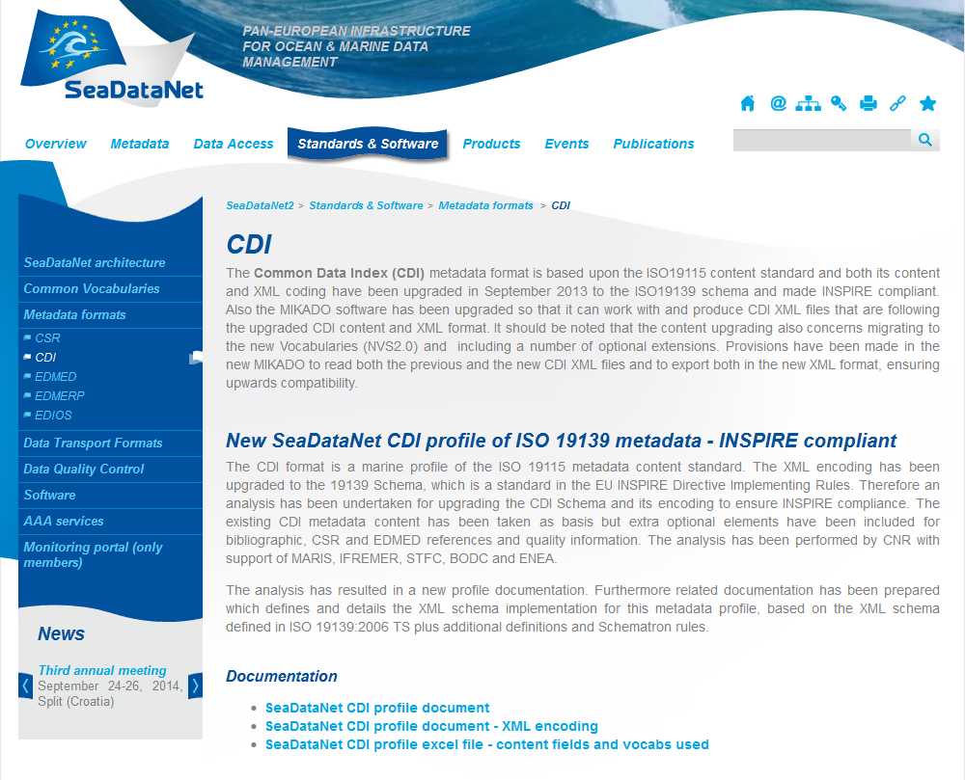
CDI ISO 19139 (1/9)
All CDI ISO 19139 documentation available at: http://www.seadatanet.org/Standards-Software/Metadata-formats/CDI

Slide 7
CDI ISO 19139 (2/9)
MIKADO generates (manually or automatically) ISO 19139 CDI descriptions instead of ISO 19115 ones.
MIKADO is still able to read (import) CDI ISO 19115 files and save them as ISO 19139 XML files for data centres to update their existing local XML files, one by one (Manual Menu: Open, Save)
XML file
ISO 19115
MIKADO 3
XML file
ISO 19139
Notes:
As MIKADO is the tool used by SeaDataNet to create ISO XML descriptions of the SeaDataNet catalogues, the part of the tool concerning CDI has been upgraded in order to be able to generate (manually or automatically) ISO 19139 CDI descriptions instead of ISO 19115 ones.
The compatibility has been kept as much as possible between the input screens of MIKADO, but some new information has been input and has leaded to the creation of new fields in MIKADO manual mode and automatic mode.
The main changes in MIKADO are :
The addition of new optional fields, such as documentation, data quality information, edmed reference and csr reference in the MIKADO CDI interface.
Some date formats have changed, such as the format of the revision date and the station date
The Sampling interval fields became Time resolution .
I am going to describe in details these changes.

Slide 8
CDI ISO 19139 (3/9)
Main changes in MIKADO
Addition of new optional fields
EDMED reference
CSR reference
Additional documentation
Data quality information
Change in date format (revision date and station date)
Change in Sampling interval

Slide 9
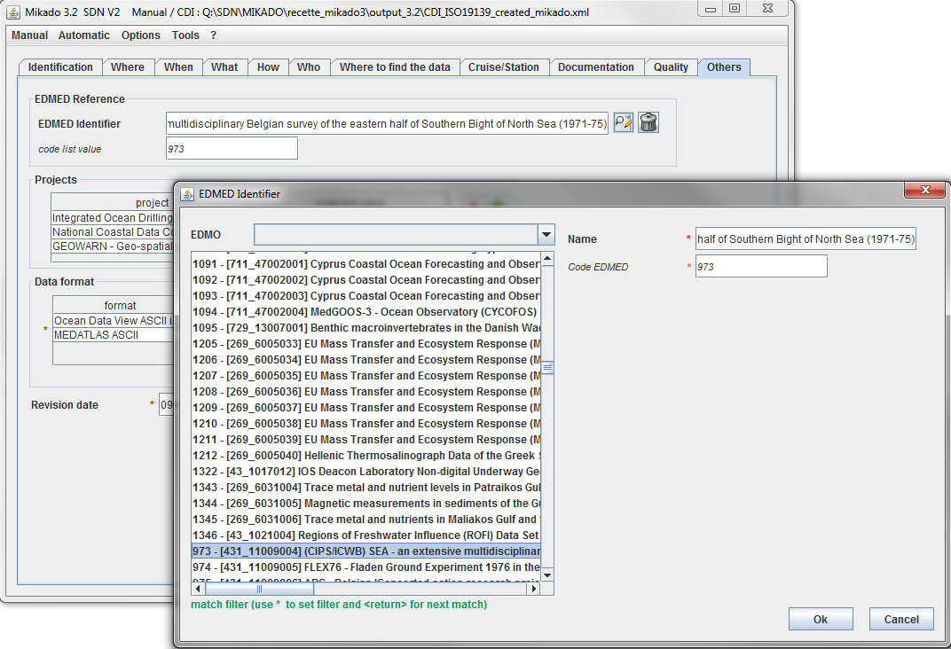
CDI ISO 19139 (4/9)
Do not forget to create first your entry in EDMED Catalogue!
EDMED Reference
A reference to the EDMED directory has been added in CDI ISO 19139 profile.
Optional field in MIKADO
EDMED reference (manual)
Dropdown list
Uploaded using webservices
Sorted by EDMO code
Var80 (automatic)
Mapping available
Central EDMEDId or EDMOCode_LocalEDMEDId
Notes:
References to … So, every CDI can be liked to a particular EDMED Entry…
Consequently, a new field has been added in the MIKADO interface.
In MIKADO manual, you could select your publications in a dropdownlist, uploaded by MIKADO using webservices.
In MIKADO automatic, you will have to include a reference to the EDMED entry in your queries. We recommend you to use EDMED Central ID or EDMOCode_LocalEDMEDId to avoid mapping during the generation of your CDI XML files.

Slide 10
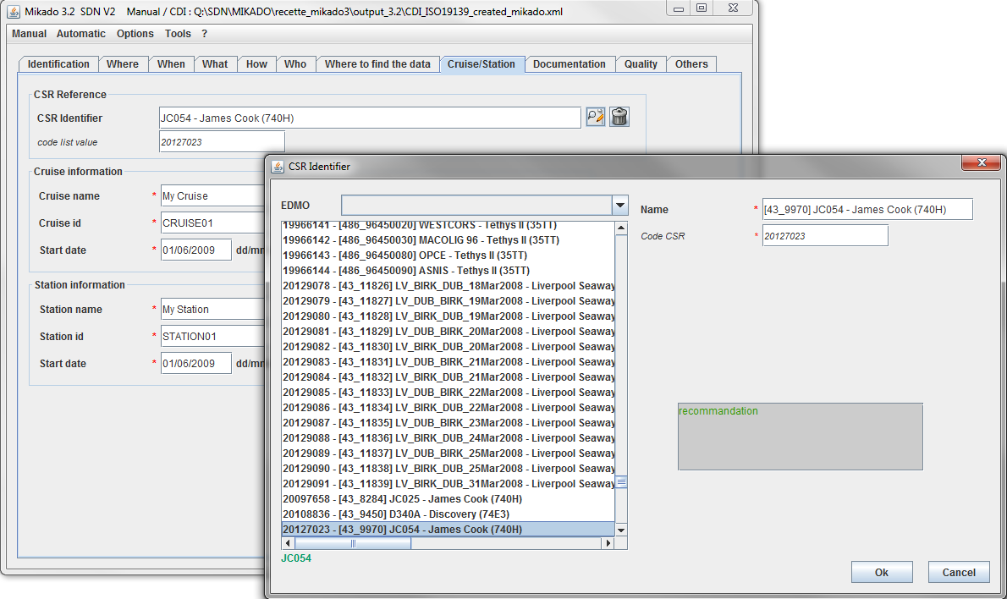
CDI ISO 19139 (5/9)
Do not forget to create first your entry in CSR Catalogue!
CSR Reference
A reference to the CSR directory has been added in CDI ISO 19139 profile.
Optional field in MIKADO
CSR reference (manual)
Dropdown list
Uploaded using webservices
Sorted by EDMO code
Var81 (automatic)
Mapping available
Central CSRId or EDMOCode_LocalCSRId
Notes:
References to … So, every CDI can be liked to a particular CSR Entry…
Consequently, a new field has been added in the MIKADO interface.
In MIKADO manual, you could select your publications in a dropdownlist, uploaded by MIKADO using webservices.
In MIKADO automatic, you will have to include a reference to the CSR entry in your queries. We recommend you to use CSR Central ID or EDMOCode_LocalCSRId to avoid mapping during the generation of your CSR XML files.

Slide 11
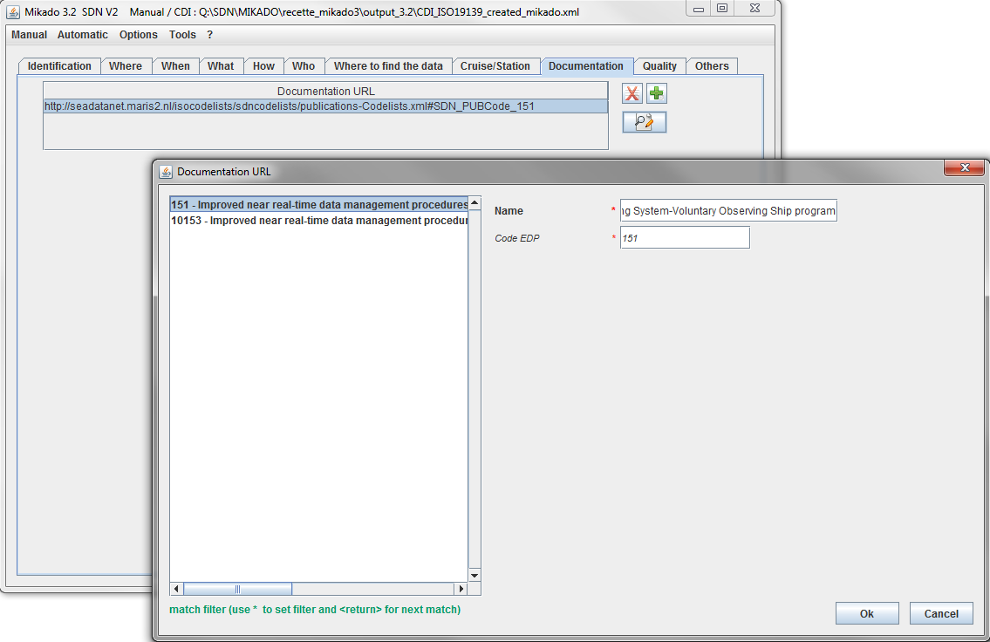
CDI ISO 19139 (7/9)
Additional documentation
References to publications and documentations have been added in CDI ISO 19139 profile. Every CDI record can reference any number of publications.
Optional field in MIKADO
Documentation tab (manual mode)
Dropdown list,
Upload using webservices
Var 90 (automatic mode)
Use of permanent URLs:
Catalogue of publications (MARIS)
Notes:
References to … So, every CDI …
Consequently, a new field has been added in the MIKADO interface.
For the sake of homogeneity and stability, these publications must be referenced in the form of permanent URLs and must be stored and identified in a central catalogue of publications managed by MARIS.
In MIKADO manual, you could select your publications in a dropdownlist, uploaded by MIKADO using webservices.
In MIKADO automatic, you will have to include a reference to MARIS publications catalogue in your queries.

Slide 12
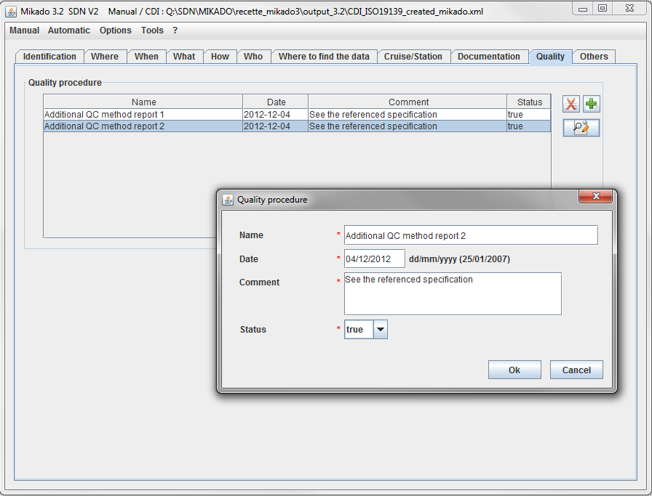
CDI ISO 19139 (5/9)
Data Quality Information
Every CDI record can reference any number of data quality reports.
Optional fields in MIKADO:
Quality tab (manual)
Var95 to var98 (automatic)
Notes:
A principle goal of CDI metadata is to ensure that the data they describe can be independently understood and used efficiently. Data quality tests and reports play a critical role in achieving this goal. Connecting these to the CDI record is clearly important.
That is why data quality information has been added in CDI ISO 19139 profile and MIKADO has been updated to integrate the following new fields:
Name: name of the QC standards applied to the data,
Date: reference date of the cited QC standards (dd/mm/yyyy),
Comment: comment or explanation about the QC evaluation and its result,
Status: indication of the conformance result (True/False).
For example, the data quality information could refer to the Manual of Quality Control Procedures for Validation of Oceangraphic Data, IOC Manuals and guides No. 26, published on 01/01/1993:
• Name = Manual of Quality Control Procedures for Validation of Oceanographic Data, IOC Manuals and guides No. 26
• Date = 01/01/1993
• Comment = See the referenced specification
• Status = true

Slide 13
CDI ISO 19139 (8/9)
Changes in date format: YYYY-MM-DDTHH:MM ➔ YYYY-MM-DD
Revision date, Station date
MIKADO manual : follow the instructions in the MIKADO interface
MIKADO automatic: use the right format to avoid « date type » error during generation (var06, var 20)
Notes:
As I said previsouly, some date formats have changed in the CDI ISO 19139 profile. So, MIKADO has been upgraded to take into account these changes.
The fields which are concerned by these changes are:
Revision date and Station Date which should not include the time

Slide 14
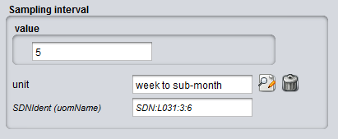
CDI ISO 19139 (9/9)
Sampling interval
“Sampling interval” ➔ “Time resolution”
“When” tab (manual)
Var21 and 22 (automatic)
Value + L031 “SDN Measurement Periodicity Categories »
Value + P06 “BODC data storage units”
P06
L031
Notes:
The last point concerning the migration to CDI ISO 19139 concerns the Sampling interval field which has been changed to Time resolution field.
….

Slide 15
How to create and update my CDI files?

Slide 16
MIKADO manual (« Manual » menu)
Create and update XML files
Create a new XML file or open your existing XML file
Fulfil or Update the different fields
Fulfil new fields if possible
EDMED reference,
CSR reference,
Data Quality,
Documentation
Save your XML file
If you do not find your EDMED, CSR and Documentation entries in MIKADO, do not forget to update the Vocabulary Lists (Menu Options)!
Notes:
MIKADO works exactly in the same way as previously

Slide 17
MIKADO automatic (« Automatic » menu)
Create and update XML files
Update your MIKADO 2.5 configuration files
Revision date (var06), Station date (var20): YYYY-MM-DD
Sampling interval (var 21,22) : Use P06 instead of L031
Fulfil the new fields if possible
EDMED reference var80,
CSR reference var81,
Data Quality var95 to var98,
Documentation var90
Save your configuration files
Generate your XML files

Slide 18
How to validate my CDI files?
IMPORTANT: The Validation Service (www.seadatanet.org/validator) is not maintained anymore.
To begin, you can open some of your XML files in MIKADO manual and check the content of the different fields.
CDI and CSR ISO19139 XML Schemas are dynamically supported by ISO XML lists for EDMED, EDMO, EDMERP, CSR, Vocabs, ISO through Schematron.
This allows to validate CDI and CSR XML entries using a XML editor (XML Spy or Oxygen or other XML editors).

Slide 19
Practical work « CDI workshop »
For experienced users
Work on your own data and your own XML files
Ask your questions,
Show your problems,
Give feedback
NEMO, MIKADO, Coupling table
NEMO and NetCDF
On Thursday during NetCDF workshop

Slide 20
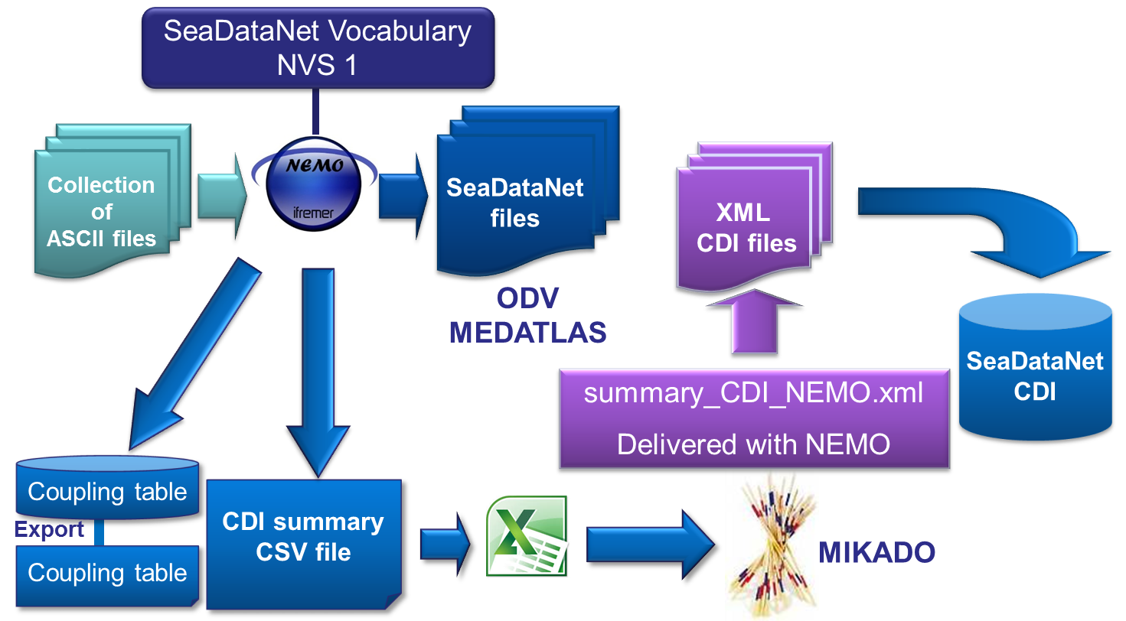
Practical work « CDI workshop »
For new users
« For new users » folder
SDNtools.ppt = lecture about NEMO and MIKADO tools
Practicalwork.ppt = exercises on NEMO and MIKADO

Slide 21
Practical work « CDI workshop »
For experienced users who did not bring their own files:
Work on the provided data and XML files in « MIKADO » folder which contains
An excel file of CDI metadata (generated by NEMO): NEMO_CDI_summary.xls
« ISO19115 » folder
a CDI ISO 19115 file: CDI_ISO19115_test_training_00005_H10.xml
a MIKADO configuration file for CDI XML generation (provided in NEMO): summary_CDI_NEMO.xml

Slide 22
Practical work « CDI workshop »
Exercise 1: MIKADO manual
Open the CDI ISO 19115 XML file in MIKADO manual
Add an EDMED reference
Add a CSR Reference
Save the CDI file (= CDI ISO 19139)
Compare the CDI ISO 19115 and CDI ISO 19139 by opening them in a text editor or in IE

Slide 23
Practical work « CDI workshop »
Exercise 2: MIKADO automatic
Open the MIKADO configuration file summary_CDI_NEMO.xml in MIKADO automatic
Modify the « Connection » in order to link this configuration file to the Excel file NEMO_CDI_summary.xls
Add an EDMED reference (var80)
Add an CSR Reference (var81)
Save the configuration file
Generate CDI ISO 19139 using this configuration file
Open one of the generated CDI XML files using MIKADO manual to check the content of the different fields

Slide 24
Thank you for your attention
Notes:
So, my presentation is finished. I hope my presentation was clear and it will help you to be ready for the first innovation cycle.

